Slide 1
SAFE Streaming Approaches for Europe
Transnational Partner Meeting 2
Streaming Concept Meeting
21st – 22nd of February 2022, Spain
Hybrid – Presence and Online
What’s laying ahead of us?
Next Steps Presentation University Paderborn
Reference Number: 2020-1-DE03-KA226-SCH-093590
Aktenzeichen der NA: VG-226-IN-NW-20-24-093590
Duration:
01.03.2021 to 28.02.2023 (24 months)
Chair of Business and Human Resource Education II Prof. Dr. Marc Beutner

Slide 2
SAFE
What‘s laying ahead of us?
SAFE - The SAFE Streaming Concept Meeting Hybrid Meeting in Presence in Spain and Online via ZOOM 21st -22nd of February 2022
Project Number: 2020-1-DE03-KA226-SCH-093590

Slide 3
Overview – Intellectual Outputs
IO1 SAFE – Acceptance of eLearning and streaming in school education in times of COVID-19
Not financed by the NA/EU – no staff budget
IO2 SAFE – The streaming concept for schools
IO3 SAFE – Teacher training course on Streamlabs OBS and use of streaming platforms
IO4 SAFE – Implementation and evaluation at schools
Not financed by the NA/EU – no staff budget
IO5 SAFE – Creation of streaming videos, didactic materials
IO6 SAFE – The teacher handbook on the eLearning approach and the SAFE-Streaming-in-School-Education-book
Not financed by the NA/EU – no staff budget
IO7 - SAFE - Policy Paper and Layman´s report learning with streaming tools

Slide 4
Project timeline - IOs
Intellectual Outputs of the SAFE project
IO2
01-06-2021 to 10-01-2021
Ongoing
IO3
01-06-2021 to 01-06-2022
Ongoing
IO5
01-09-2021 to 01-12-2022
Ongoing
IO6 01-03-2022 to 28-02-2023
Starts soon
Start of the project
March
2021
- Finish - End of the project February 2023
July 2021
November
2021
March
2022
July
2022
November 2022

Slide 5
Next steps - Summary
Please have a closer look into the workplan to get further details for next project activities and its deadlines!
IO2: Research on learning with serious games in higher education
(Development of a common streaming concept for schools)
IO3: Development of the Creator Tool
(Revision of the curriculum & technical issues)
IO5: Creation of Streaming videos, didactical materials
(The video, which was filmed at the same time as the workshop, is a first step)
IO6: Development of Book
(Creation of a first draft structure)

Slide 6
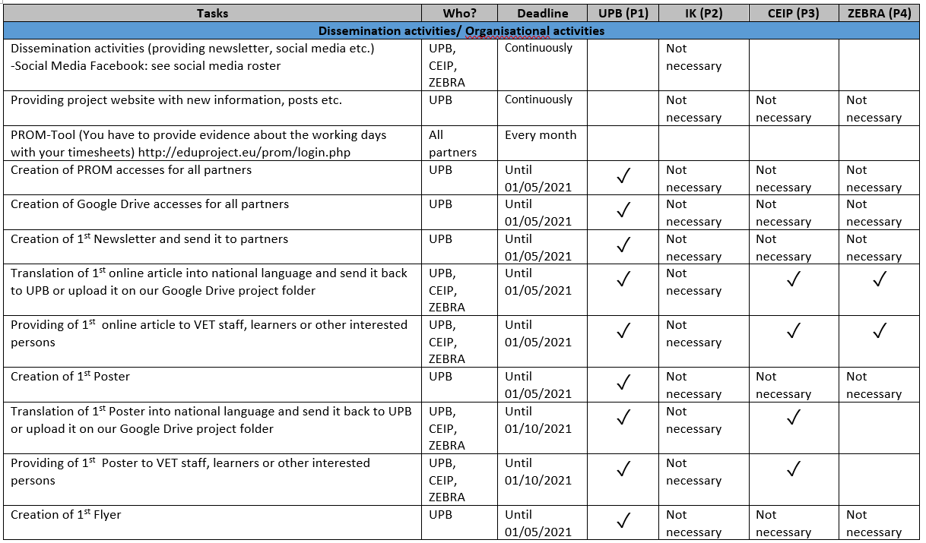
Next steps – Workplan – General & Dissemination

Slide 7
Next steps – Workplan – General & Dissemination

Slide 8
Next steps – Workplan – General & Dissemination

Slide 9
Next steps – Workplan – IO1
If you are interested in more details, please check the work plan for the current status.
IO1 is not funded and will not be considered further for the time being. Nevertheless, results for IO1 are available.

Slide 10
Next steps – Workplan – IO2

Slide 11
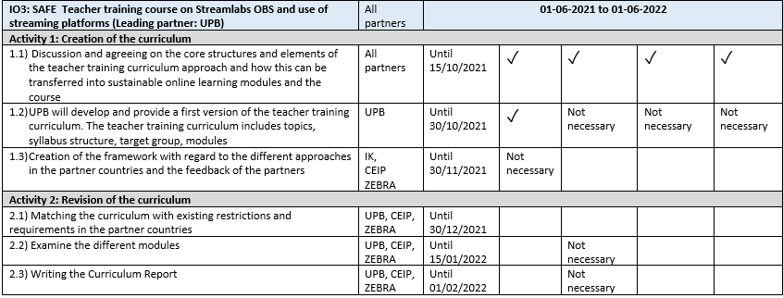
Next steps – Workplan – IO3

Slide 12
Next steps – Workplan – IO3

Slide 13
Next steps – Workplan – IO4
IO4 is not funded and will not be considered further for the time being.
However, we consider the results of IO4 to be very important, especially for the participating schools.

Slide 14
Next steps – Workplan – IO4
IO4 is not funded and will not be considered further for the time being.
However, we consider the results of IO4 to be very important, especially for the participating schools.

Slide 15
Next steps – Workplan – IO5

Slide 16
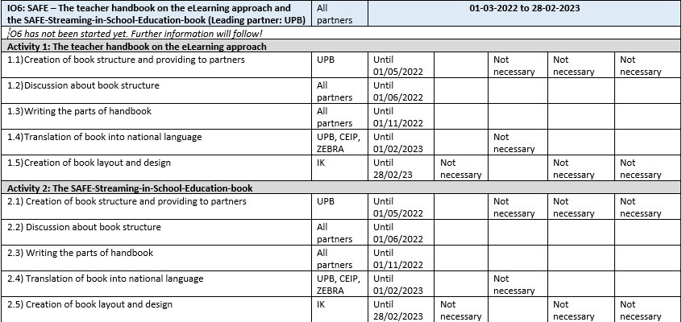
Next steps – Workplan – IO6

Slide 17
Next steps – Workplan – IO7

Slide 18
Project timeline - Meetings
Meetings of the SAFE project
Save the date: 5th – 7th of December 2022
Save the date: 27th – 29th of June 2022
Meeting 4,
Cologne, Germany
Meeting 3,
Hefmanskeho Mestec, Czech Republic
Meeting 1
Paderborn, Germany
Meeting 2
Fuensalida, Spain
Phase of Constitution
Start of the project
March
2021
- Finish - End of the project February 2023
July 2021
November
2021
March
2022
July
2022
November 2022

Slide 19
Universität Paderborn
Department : Wirtschaftspädagogik – Business and Human Resource Education Lehrstuhl Wirtschaftspädagogik II Warburger Str. 100
33098 Paderborn
http://www.upb.de/wipaed
https://safe.eduproject.eu/
Prof. Dr. Marc Beutner
Tel: +49 (0) 52 51 / 60 - 23 67
Fax: +49 (0) 52 51 / 60 - 35 63
E-Mail: marc.beutner@uni-paderborn.de

