Slide 1
SAFE
Streaming Approaches for Europe
Final Transnational Partner Meeting
8th of February, 2023
ADMINISTARIONS
University of Paderborn
Reference Number:
2020-1-DE03-KA226-SCH-093590
Aktenzeichen der NA:
VG-226-IN-NW-20-24-093590
Duration:
01.03.2021 to 28.02.2023 (24 month)
Chair of Business and Human Resource Education II
Prof. Dr. Marc Beutner

Slide 2
Overview
I Summary for the Final Financial Report
II Detailed Information
  Part I - General information
  Part II - Financial reporting
  Part III - The Project Management Tool – PROM

Slide 3
I Summary for the Final Financial Report

Slide 4

What we need for the Final Report
The coordinator needs from the partner organisations
  1. Signed and stamped Timesheets
  PLEASE create one pdf. for one staff member (for the whole project lifetime and send them even sign and stamp the 0- Timesheets)
  as scan to Jennifer and Marc
  Originals via Post to
    Universität Paderborn
    Prof. Dr. Marc Beutner
    Warburger Str. 100
    33100 Paderborn (Germany)
  2. Contracts from the staff members (payment records if possible) (just from this staff, who get Timesheets)
    As scan to Jennifer and Marc
    In your folders if their comes to a deep audit
    Declaration of Employment
  3. Travel Cost records
    Print them in Prom, than sign and stamp the records
    Send the records via mail
Deadline for the documents: 28.02.2023

Slide 5
II Detailed Information

Slide 6
Part I - General information

Slide 7
Responsibilities of the beneficiaries
„All beneficiaries
are jointly and severally responsible for proper implementation of the project and for complying with any legal obligation each beneficiary
informs the coordinator of any change with effects on the project
submits to the coordinator:
- data needed for reports and financial statements
- documents needed for audits, checks, evaluation
- any other information to be provided to the NA“
(Presentation Strategische Partnerschaften Administrative und finanzielle Projektbegleitung Jürgen van
Capelle / Katarzyna Sena, )

Slide 8
Responsibilities of the coordinator
„The coordinators*
monitor the implementation
intermediate the communications between beneficiaries and NA
provide NA with information related to substantial changes in the project
establish requests for payment / ensures payments to the other beneficiaries
provides necessary documents for checks, audits, evaluations. * Grant agreement, II,1.3“
(Presentation Strategische Partnerschaften Administrative und finanzielle Projektbegleitung Jürgen van
Capelle / Katarzyna Sena, )

Slide 9
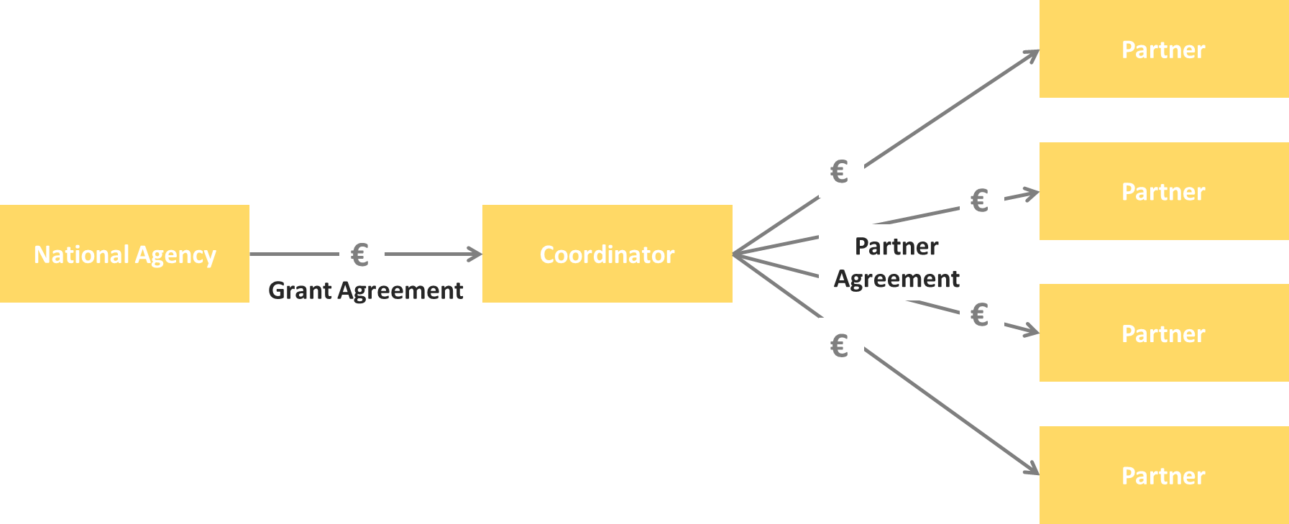
Scheme of the money-transfer

Slide 10
Eligible costs
“Eligible Costs (1) (PG, p. 200)
Incurred during the lifetime of the project
Indicated in the estimated overall budget of the project
Necessary for the implementation of the project
Identifiable and verifiable (recorded in the accounting records with regular cost accounting practices)
Compliant with the requirements of applicable tax and social legislation
Reasonable, justified, and comply with sound financial management (regarding economy and efficiency)
Always beware: VAT”
(Presentation Strategische Partnerschaften Administrative und finanzielle Projektbegleitung Jürgen van Capelle / Katarzyna Sena, )

Slide 11

Cost types
Unit costs
Intellectual Outputs
Project Management and Implementation
Transnational Project Meetings
Multiplier Events
Learning, Teaching and Training Activities
Actual Costs
Exceptional Costs
Relevant in EDU-VET for all partners
Not in the EDU-VET project
Relevant in EDU-VET for Ingenious Knowledge

Slide 12
Unit costs
What are unit costs?
Unit costs...
occur within the period of eligibility
are necessary to realise and implement the project
have to be reported → Financial documentation
Could be identified and verified by financial documentation
Project Management and Implementation
Coordinator → €500 per month
Partners → €250 per month

Slide 13
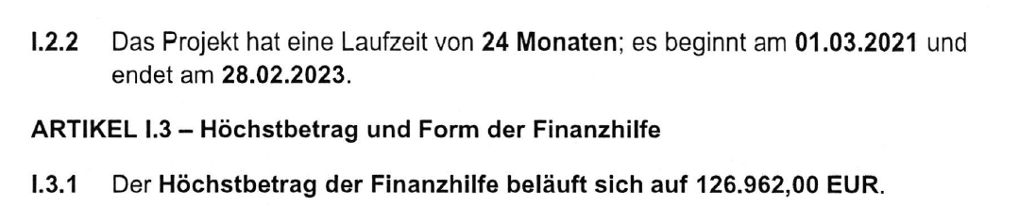
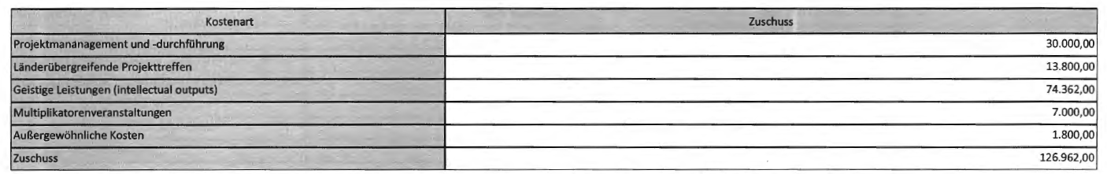
Application Budget of the
SAFE project
Grant Agreement: (German language)
The management and implementation budget is granted as a monthly lump sum!
Annex II of the Grant Agreement is identical with application:
This means, that there are no reductions.

Slide 14
Project Management and
Implementation
Could be used for...
general project management tasks / coordination
communication / planning / calculation purposes
project and Intellectual Output implementation purposes
dissemination and evaluation
Could be identified and verified through...
produced dissemination material / products
explanation and description in the progress and the final report
Development of a dissemination list

Slide 15
Intellectual Outputs (1)
Intellectual Outputs...
will be developed by staff members in specific staff categories
produces staff costs that could be characterised by 4 different staff categories:
  Manager
  Teacher/Trainer/Researcher
  Technician
  Administrative staff
are calculated on unit costs per day

Slide 16
Intellectual Outputs (2)
You provide evidence about the working days with your time sheets! –
Use the PROM TOOL!
Please make sure that you do not claim more or less days than granted!
http://prom.eduproject.eu/

Slide 17
Intellectual Outputs (3)
Documentation of staff costs
  Timesheets
  Payslips
  Staff employment contracts
Additional documentation (in your own project folder)
  Invoices (for example: boarding passes, accommodation invoice etc.)
  Proof of payment
  Receipts for costs incurred (for example: printing costs for dissemination material, hosting partner meeting etc.)

Slide 18
Travel costs (1)
Transnational Project Meetings costs…
are calculated on a unit cost basis according to the distance of travel per meeting
  Online distance calculator
  http://ec.europa.eu/programmes/erasmus-plus/resources_en#tab-1-4
are based on the place of origin and the place of the meeting venue
needs to have a direct link to project meetings

Slide 19
Travel costs (2)
Transnational Project Meetings costs…
575,00 € per person distance 100-1999km
760,00 € per person distance >= 2000km
Make sure that you have the correct number of participants.

Slide 20
Travel costs (3)
Documentation
Certificate/declaration of attendance
The hosting institution has to provide the participants with a
certificate/declaration of attendance signed by the hosting organisation
→ Template will be available on the project website
→ Please provide us with a scanned version
Travel cost invoices (in your own folder)
  Flight invoices, boarding passes
  accommodation invoices
  Taxi, train, car hire and/or bus receipts
  Mileage costs at a maximum rate of 0.22 cent per km

Slide 21
Part II - Financial Reporting

Slide 22
Financial Reporting
Please…
provide all financial and supporting documents every
4 months (first year) and every 3 months (second year).
use the PROM Tool to create your financial documentation.
stick on the working days per Intellectual Output and staff category.
create one timesheet per month.
ensure that you only report one staff category per month.
don`t report Saturdays, Sundays, holidays and sick days.
sign timesheets for every month.
send all documents of a reporting period in one package via e-mail and
the originals via post.

Slide 23
Part III –
The Project Management Tool - PROM

Slide 24

PROM – Project Management Tool
The Login Area - http://eduproject.eu/prom/login.php

Slide 25
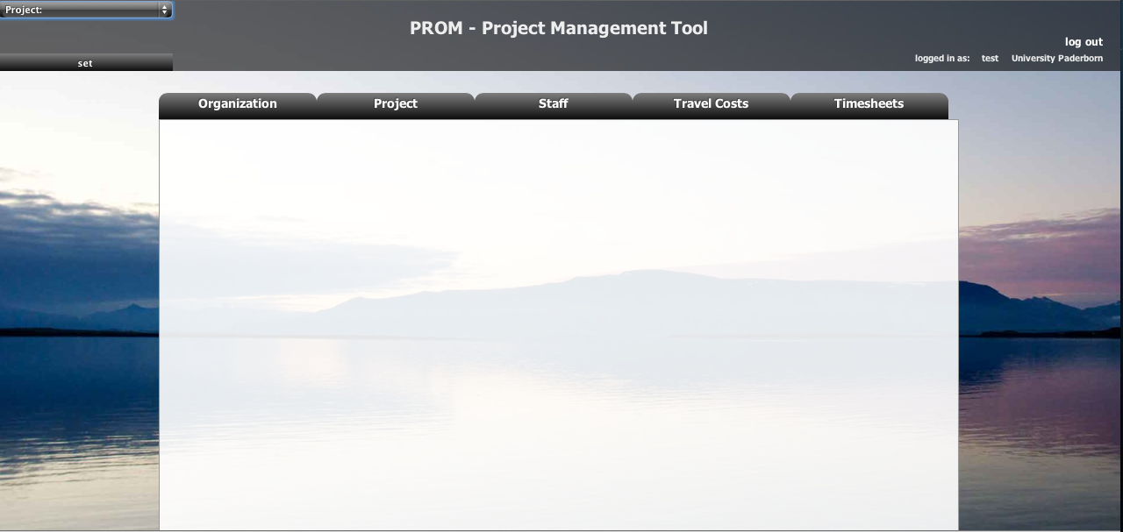
PROM – Project Management Tool
The PROM Start Page (1)

Slide 26
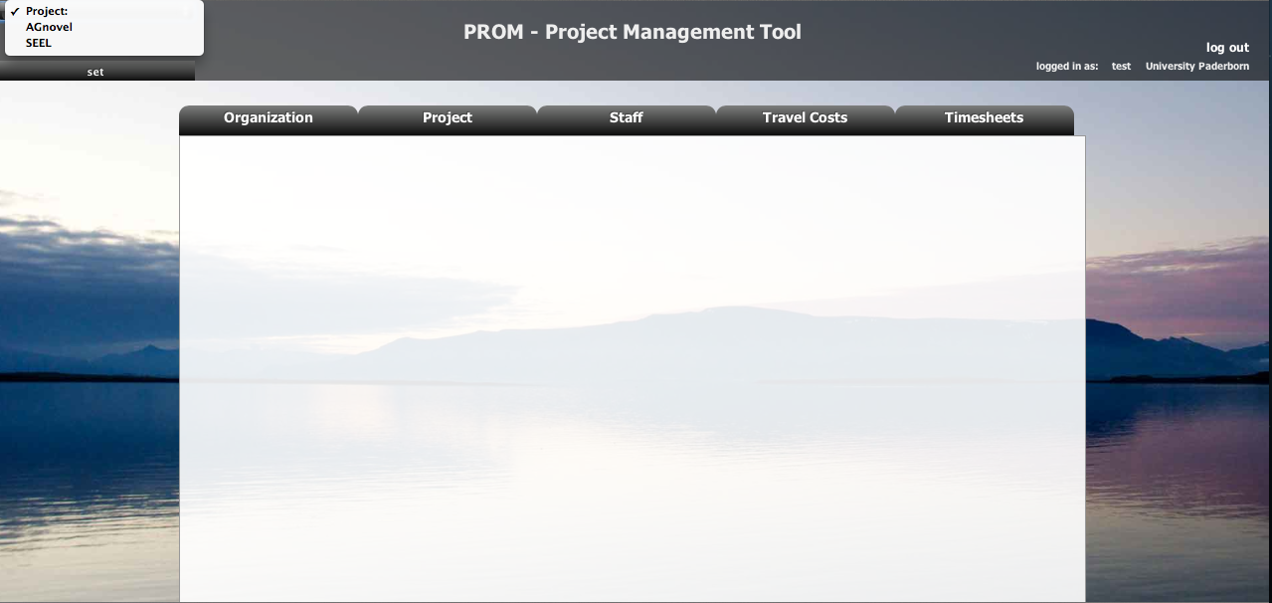
PROM – Project Management Tool
The PROM Start Page (2) – Set the project

Slide 27
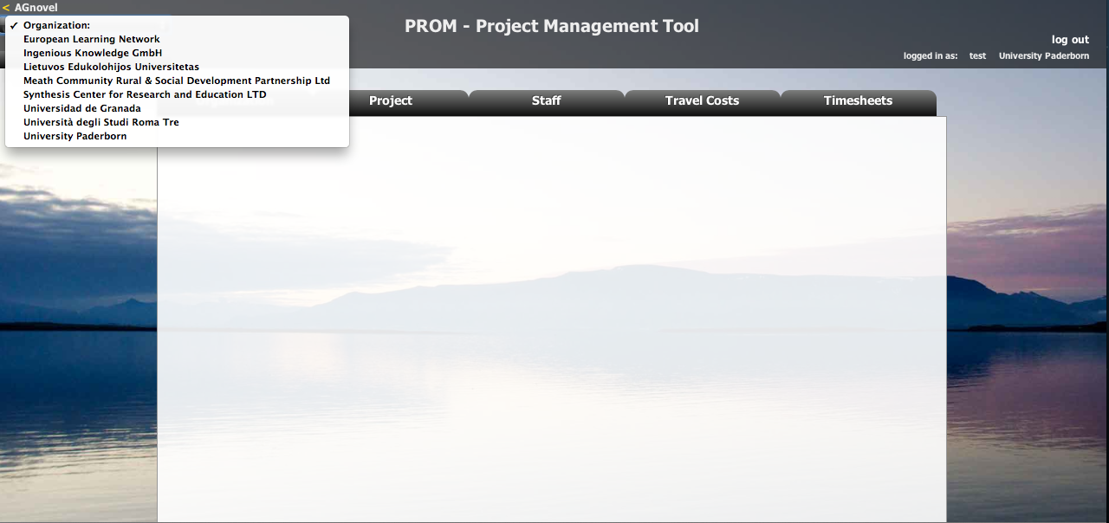
PROM – Project Management Tool
The PROM Start Page (3) – Set the organization

Slide 28
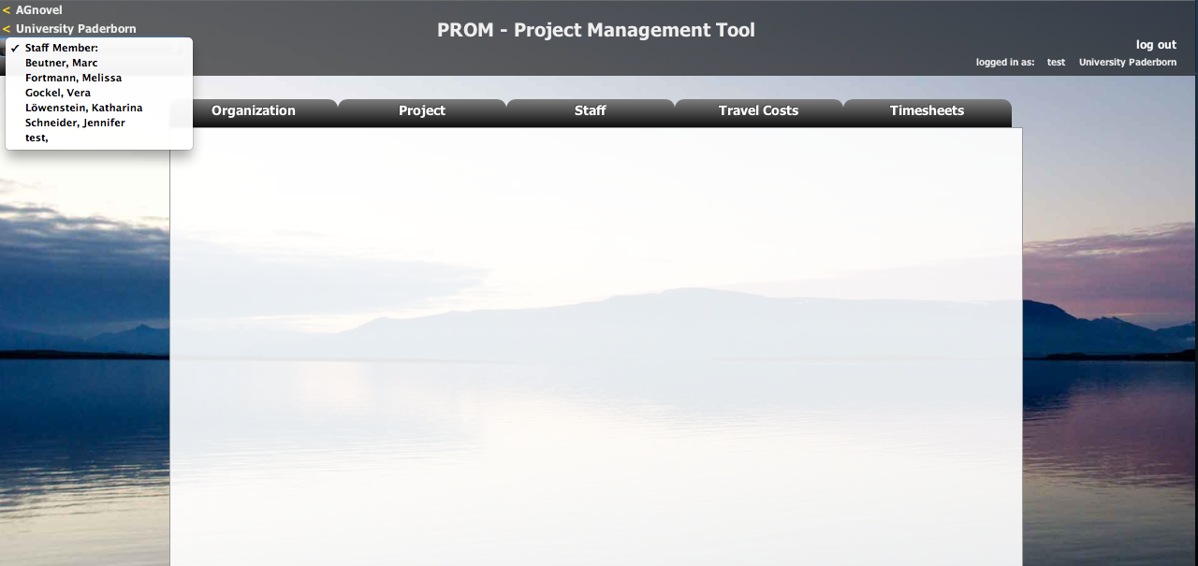
PROM – Project Management Tool
The PROM Start Page (4) – Set the staff member

Slide 29
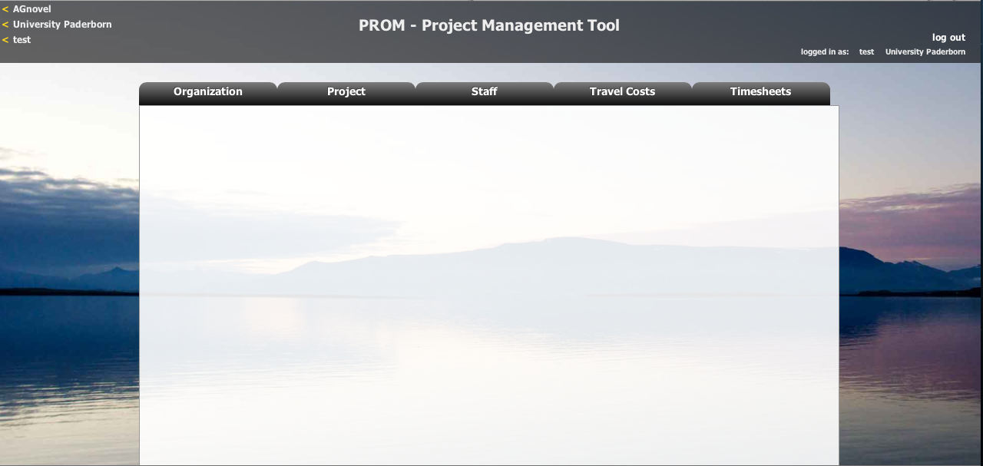
PROM – Project Management Tool
The PROM Start Page (5) – Start

Slide 30
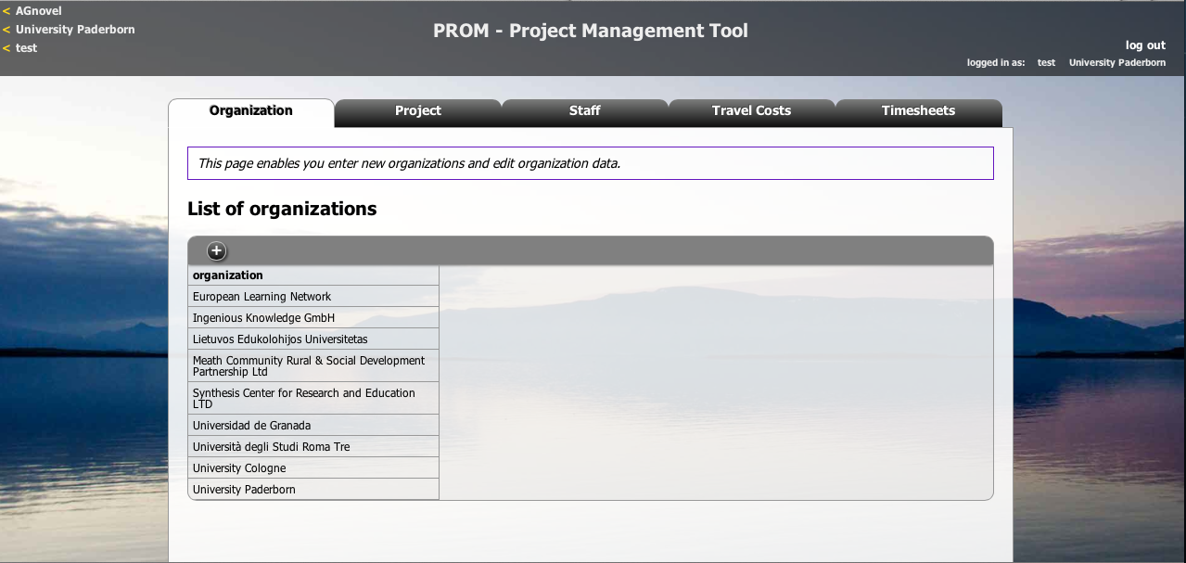
PROM – Project Management Tool
The PROM Tool – List of organizations

Slide 31
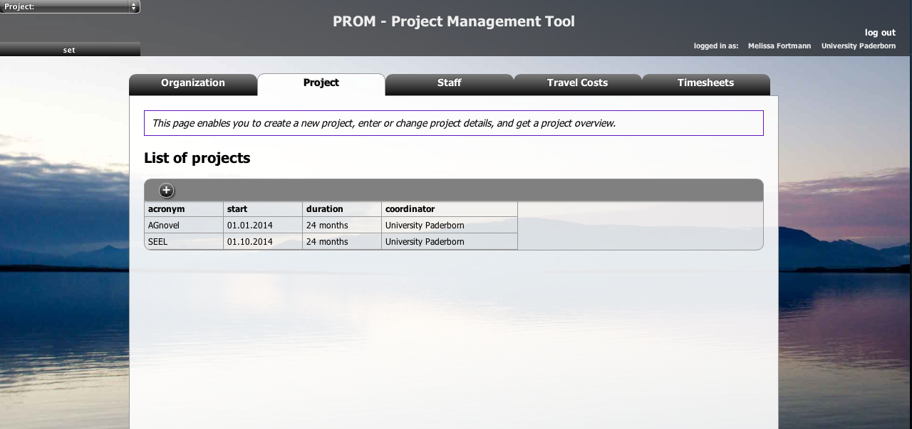
PROM – Project Management Tool
The PROM Tool – List of projects

Slide 32
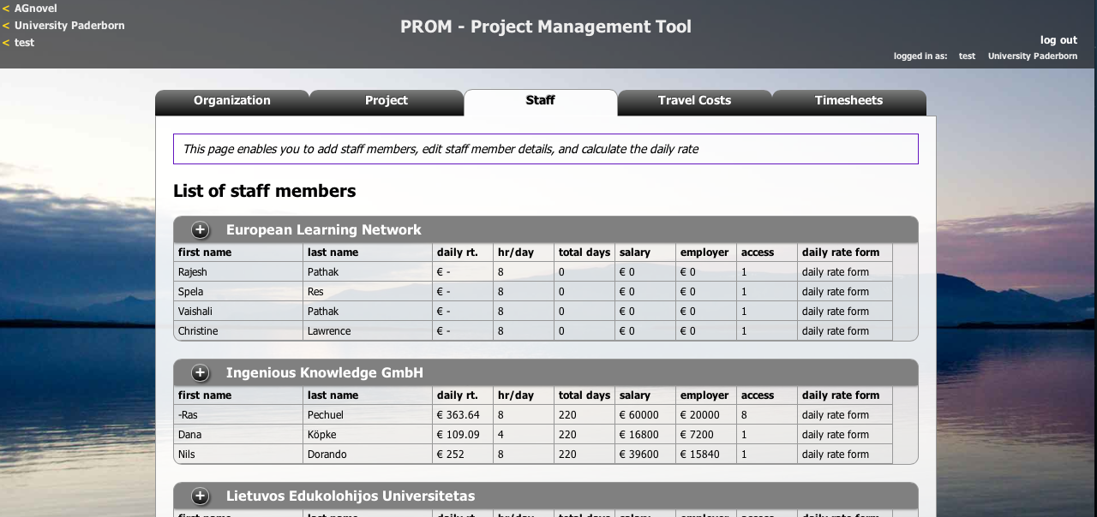
PROM – Project Management Tool
The PROM Tool – List of staff members

Slide 33
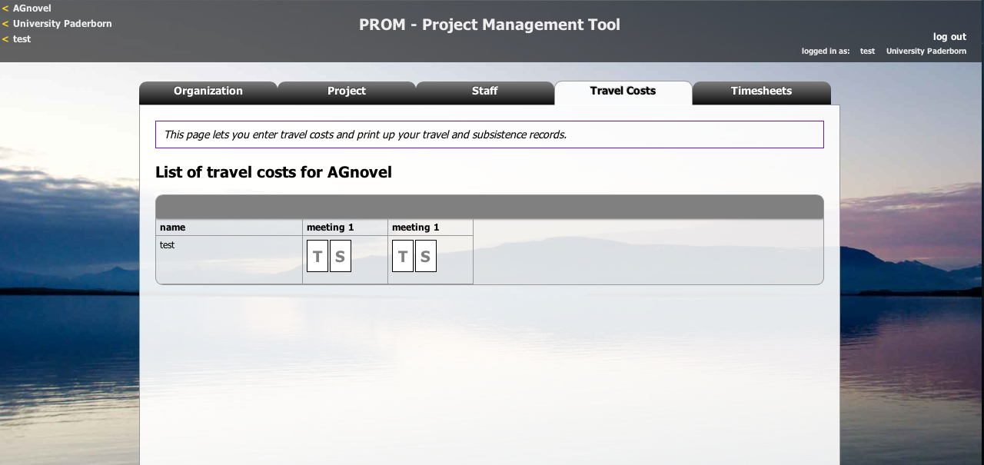
PROM – Project Management Tool
The PROM Tool – Travel costs (1)

Slide 34
PROM – Project Management Tool
The PROM Tool – Travel costs (2) – Travel record I

Slide 35
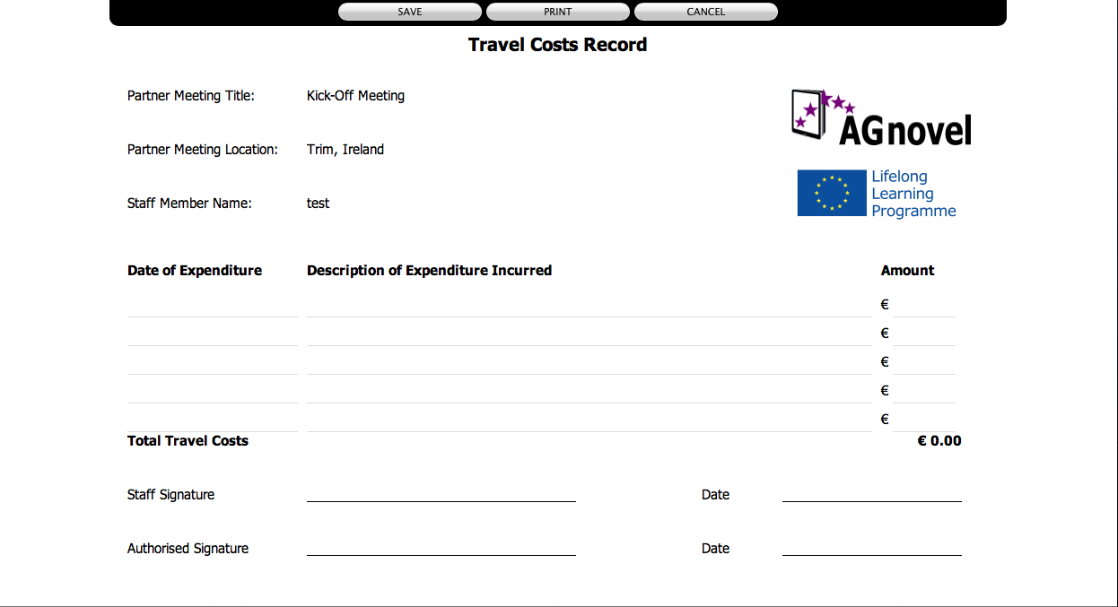
PROM – Project Management Tool
The PROM Tool – Travel costs (3) – Travel record II

Slide 36

PROM – Project Management Tool
The PROM Tool – Travel costs (4) – Subsistence costs I

Slide 37

PROM – Project Management Tool
The PROM Tool – Travel costs (5) – Subsistence costs II

Slide 38
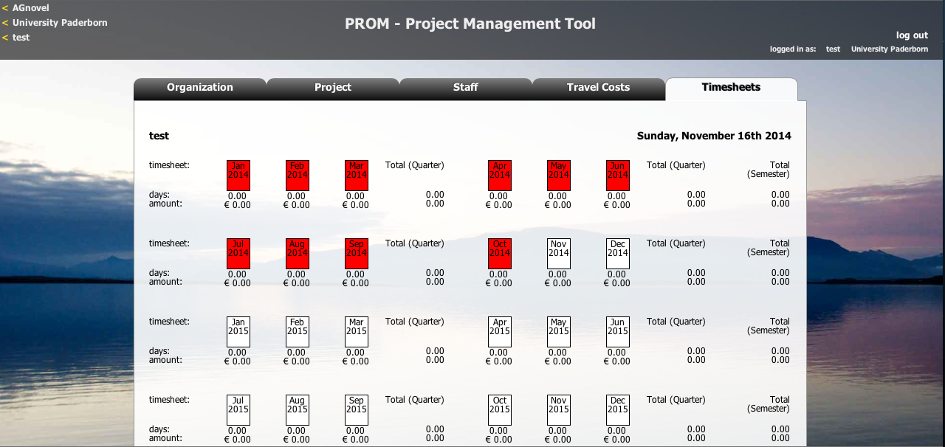
PROM – Project Management Tool
The PROM Tool – Timesheets (1) – Select the month

Slide 39
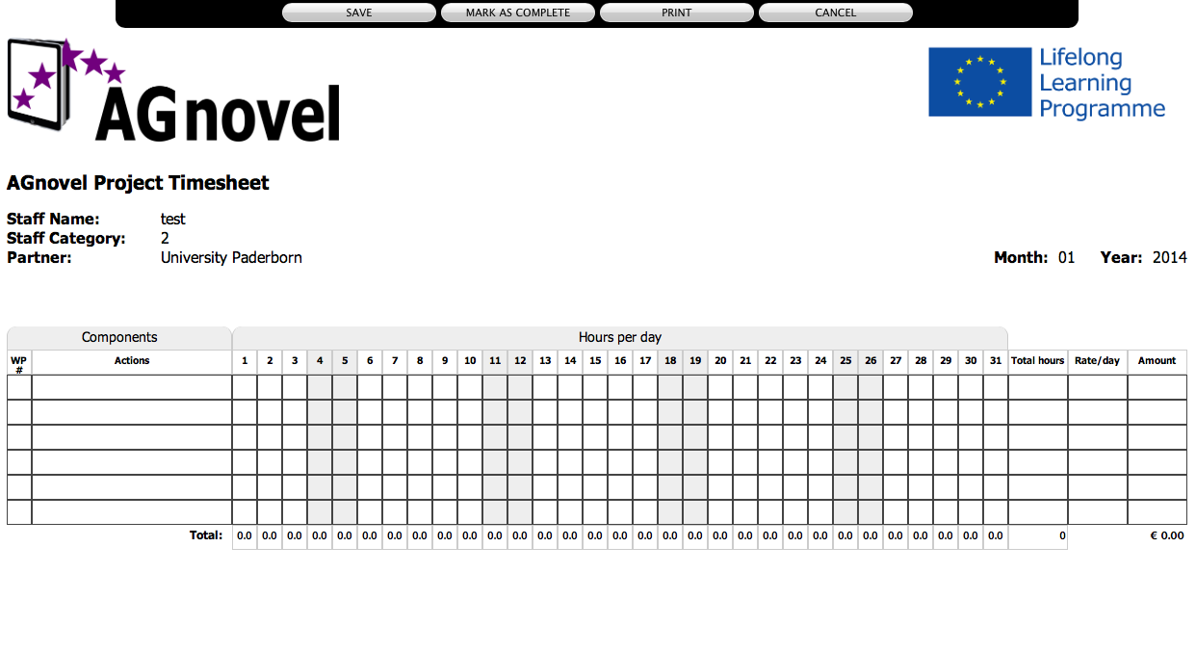
PROM – Project Management Tool
The PROM Tool – Timesheets (2) – Fill in the form I

Slide 40
PROM – Project Management Tool
The PROM Tool – Timesheets (3) – Fill in the form II

Slide 41

PROM – Project Management Tool
The PROM Tool – Timesheets (4) - Overview

Slide 42
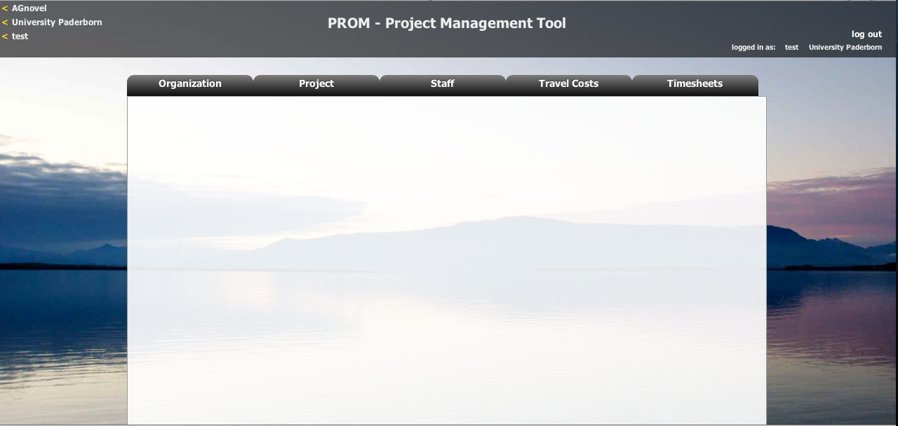
PROM – Project Management Tool
The PROM Tool – Log out

Slide 43
Universität Paderborn
Department Wirtschaftspädagogik Lehrstuhl Wirtschaftspädagogik II Warburger Str. 100
33098 Paderborn
http://www.upb.de/wipaed
http://https://safe.eduproject.eu/
Prof. Dr. Marc Beutner
Tel: +49 (0) 52 51 / 60 - 23 67
Fax: +49 (0) 52 51 / 60 - 35 63
E-Mail: marc.beutner@uni-paderborn.de

