Slide 1
SAFE Streaming Approaches for Europe
Erasmus+ project SAFE
THE DISK – Online Approach
University of Paderborn,
Prof. Dr. Marc Beutner
Reference Number: 2020-1-DE03-KA226-SCH-093590
Aktenzeichen der NA: VG-226-IN-NW-20-24-093590
Duration:
01.03.2021 to 28.02.2023 (24 month)
Chair of Business and Human Resource Education II Prof. Dr. Marc Beutner

Slide 2
THE DISK – Online Approach
(Beutner/ Pechuel 2020)

Slide 3
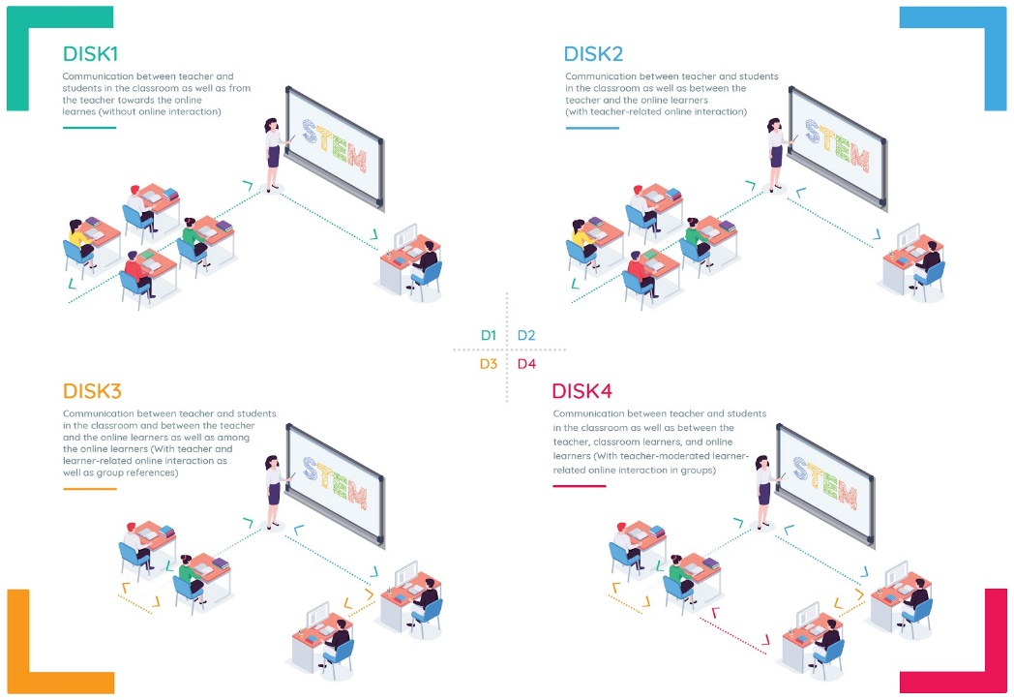
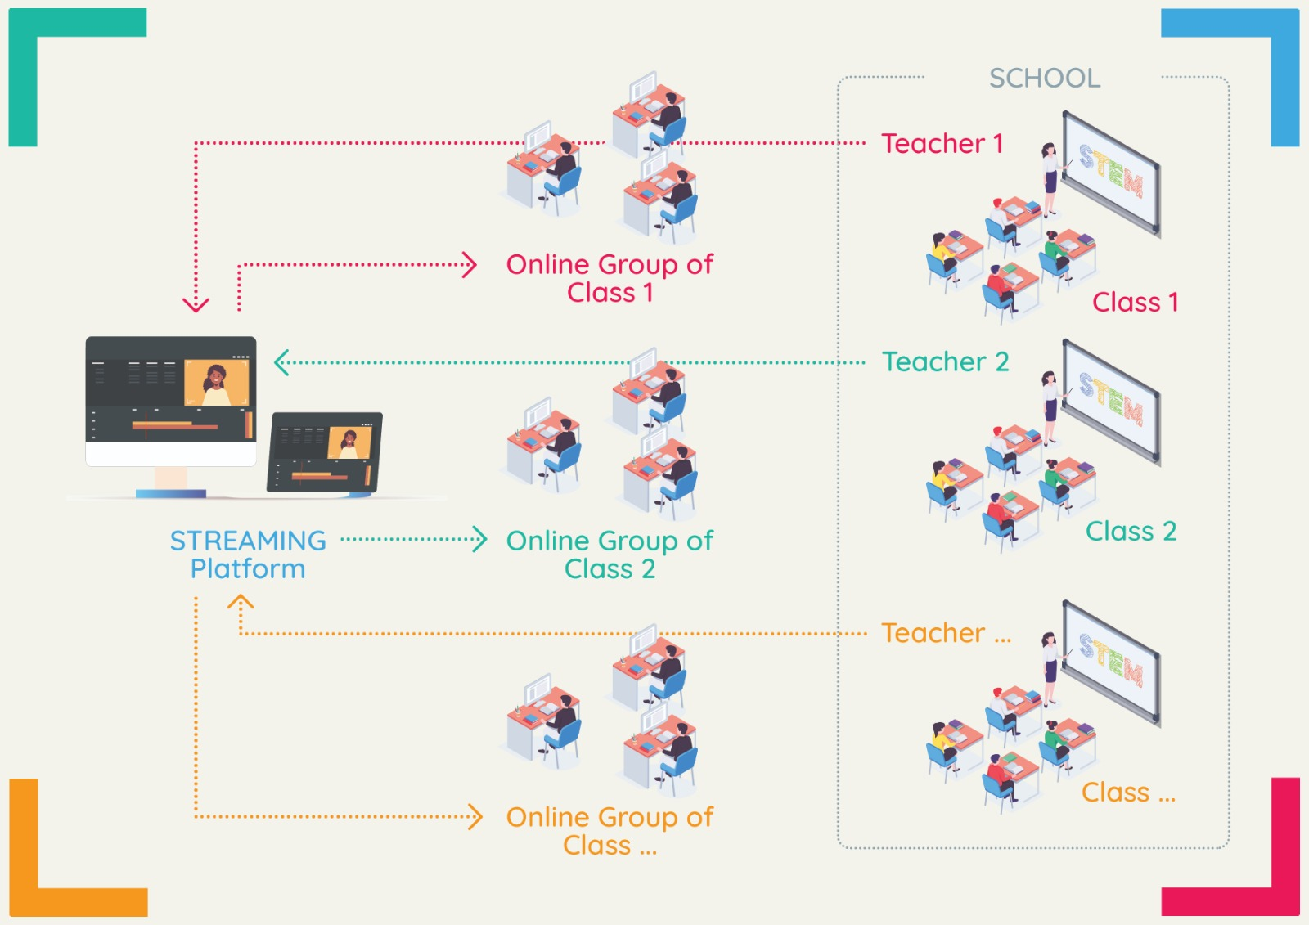
The DISK – Online Approach

Slide 4
2020 - 2021: European Education meets the COVID-19 Pandemic
Physical Distancing
contact restrictions /gathering regulations
safety distance
Personal safety
mask requirements
hygiene
Infection Control Concepts
Self-isolation
Data collection and Tracing chains
Emergency plans

Slide 5
2020 - 2021: European Education meets the COVID-19 Pandemic
Physical Distancing
Personal safety
Infection Control Concepts
In school education under specific regulations
Hybrid schooling (at school and at home)
Problem: Little pedagogical guidance for schools during the crisis.
Schooling at home (completely at home)

Slide 6
Mobile Learning can be a way of dealing with the challenges
“Mobile learning is the use of portable devices, like mobile phones, tablets and laptops in pedagogical formal, non-formal and informal settings with an emphasis on supporting the learning process and the necessary feedback processes. It combines information exchange, acquisition of knowledge, collaboration and competence development and often offers the use of the internet as well.”
(Beutner, Pechuel 2020, 22 or2012)

Slide 7
The DISK-Online Approach
The DISK-Online model offers a perspective to integrate mobile learning in combination with hybrid or online learning in educational scenarios.
DISK - Didactic Interactive Streaming Know-how
provides a quick solution to tackle the problems schools have when forced to implement distance learning in times of a pandemic.

Slide 8
Idea of the DISK approach
The core idea of the DISK model is to stream from a mobile device to learners at home and combines this with a blended learning approach.
In general DISK describes how teachers can connect with groups of learners through live streaming class content.
The learners are either not present or only partially present in the classroom.

Slide 9
Basic structure of the DISK approach
Teacher with mobile device
App for writing on the screen
Face of the teacher can be shown via an integrated camera Camera to provide classroom impression
Learners at home
Stream / Streamlabs OBS
Possible interaction
Learners in the classroom
Interaction

Slide 10
Dealing with groups in the DISK approach
 | Subgroup of the class present in the classroom | Subgroups of the class participating in the class online
First day of teaching | Group A | Group B Group C
Second day of teaching | Group B | Group A Group C
Third day of teaching | Group C | Group A Group B
(cf. Beutner & Pechuel 2020a)

Slide 11
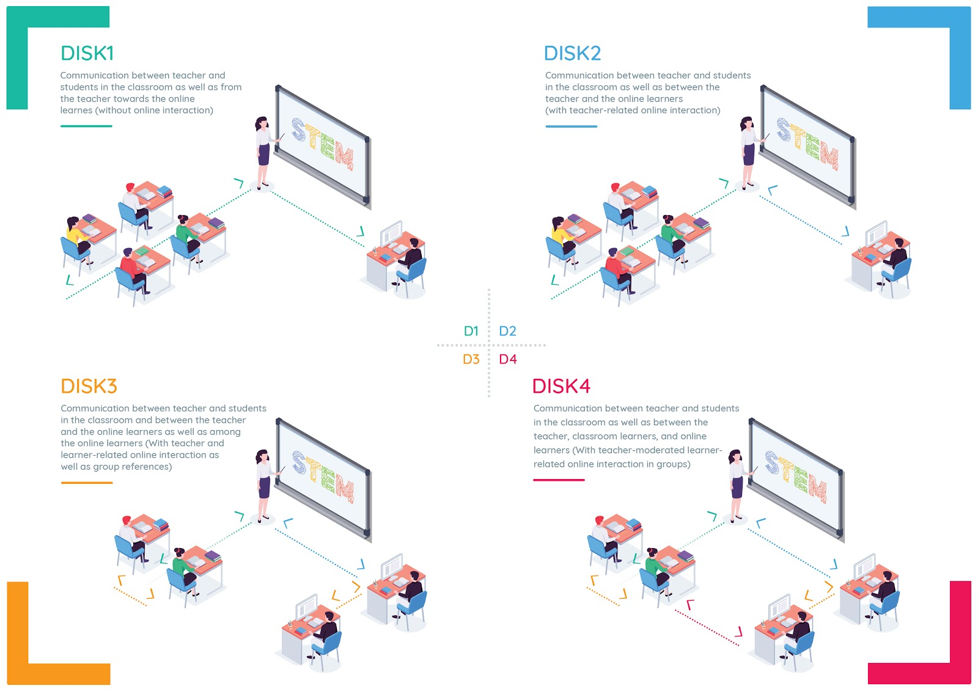
The four DISK implementation levels Beutner / Pechuel 2020

Slide 12
DISK Streaming in class

Slide 13
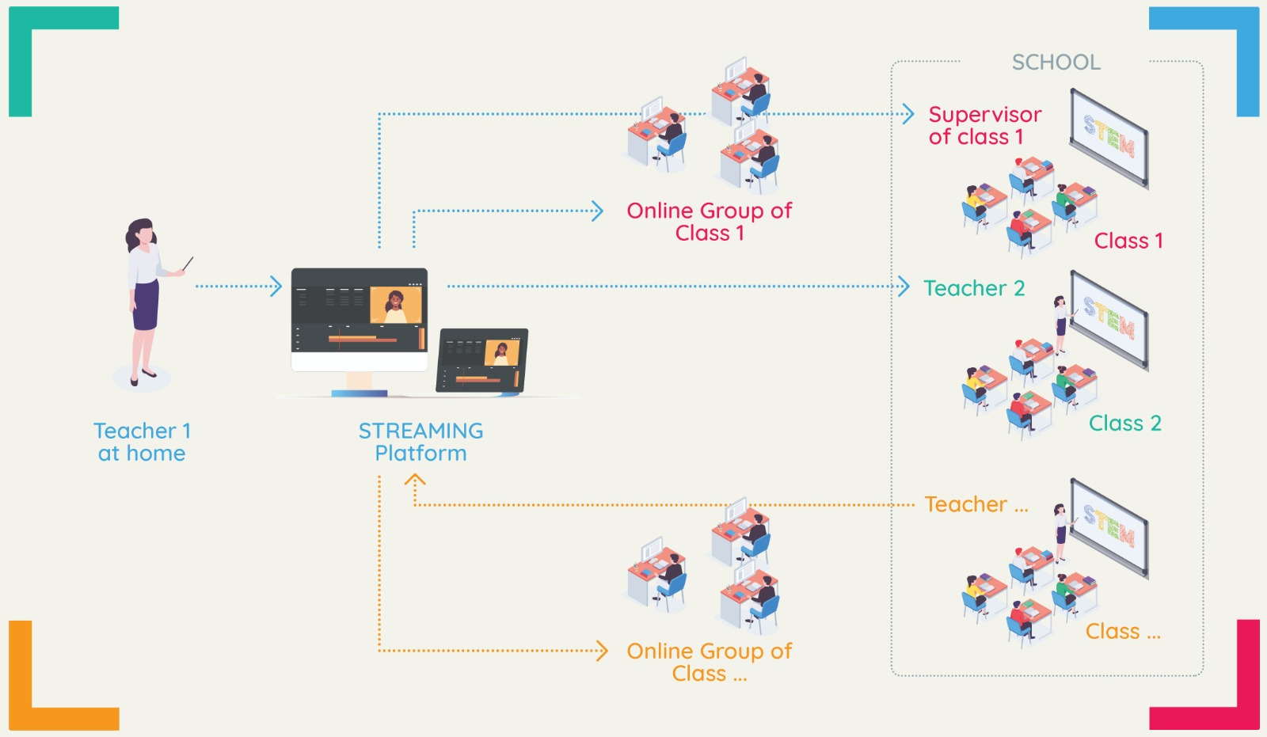
DISK Streaming from home

Slide 14
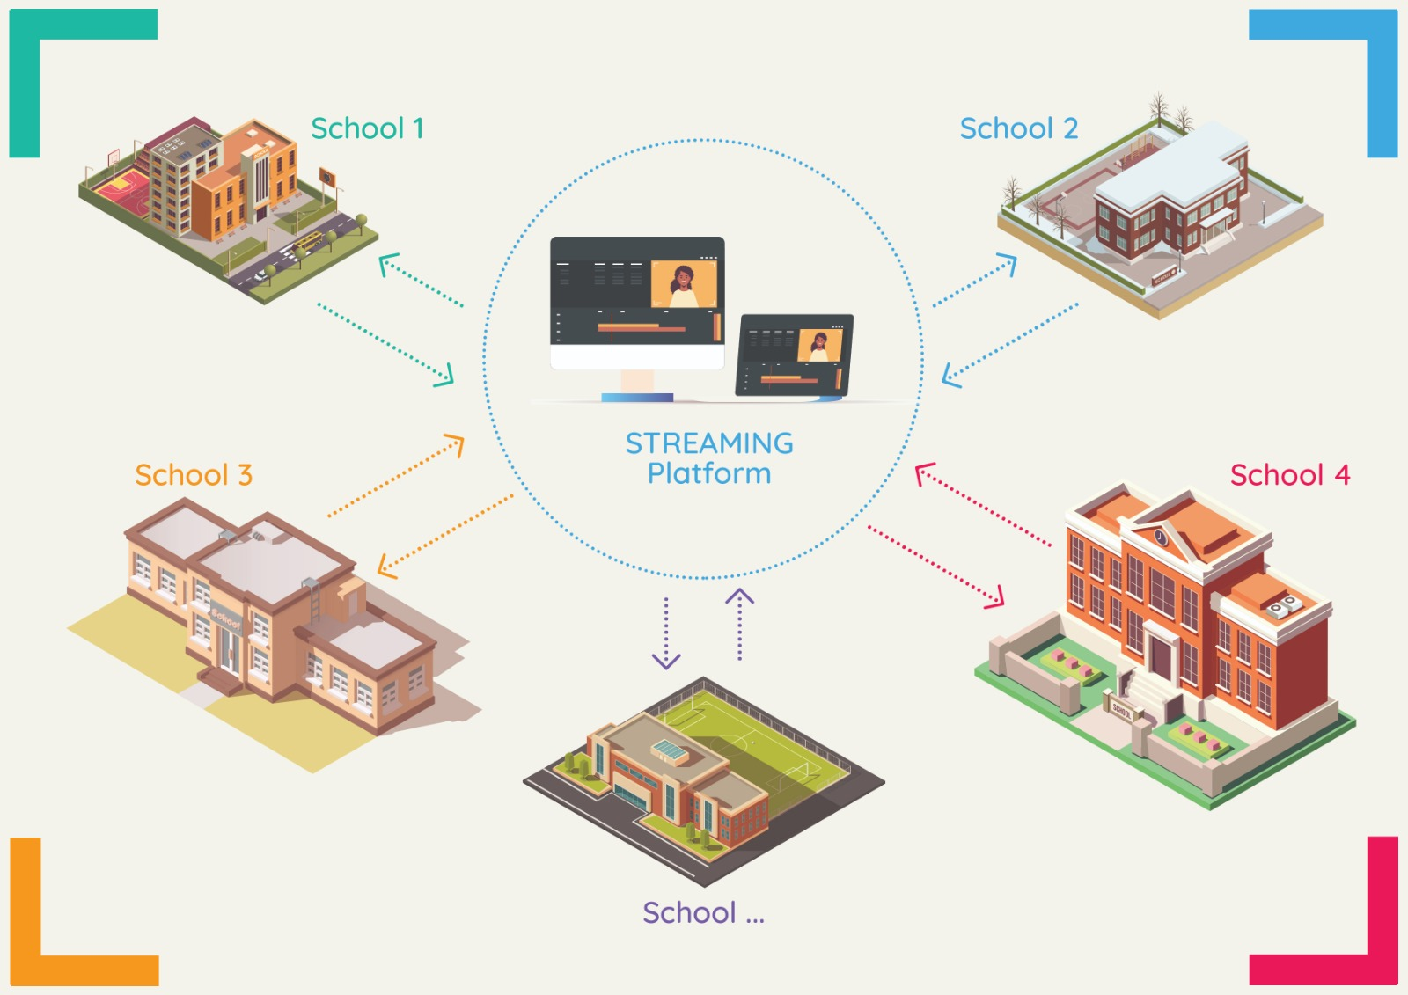
DISK with several schools

Slide 15
DISK and the technical requirements
Technical Requirements
WiFi Router and fast Internet Access
Projector and projection screen
Tablet and Digital Pen
Microphone

Slide 16
DISK Studies
Teachers and learners at VET schools in Germany interviews and short questionnaires in September/October 2020
50 interviews with teachers 35 telephone interviews with learners
Basic structures of Mayring2000and Strauss / Corbin 1998
MAXQDA labeling Questionnaires: 104 VET teachers Questionnaires :126 VET learners
Testings of the DISK approach
Teacher Students survey

Slide 17
Compiled impressions from the study results
German learners stated that they enjoyed learning via the mobile opportunity at home.
94% stated that they had no problems getting a device and every learner said that they were able to get online after getting a device.
98% of the learners stressed that they had no problem connecting the streaming portal with mobile devices.
Our learners mentioned that they would be happy to get direct explanations (33 of 35 learners) and would like to have more interaction.

Slide 18
Compiled impressions from the study results
93,33% of the teacher students were ́very happy ́ and one teacher stated that she was ́happy with the results ́ (6,66% -1 person).
93,33% found it very easy to use streaming for schooling at home and the other teacher answered that it was easy to use streaming.
The teachers think that the concept enhances mobile learning and interactive activities at school. Many teachers described DISK-Online as a smooth path into hybrid learning and an opportunity to establish mobile approaches at school.

Slide 19
Universität Paderborn
Department Wirtschaftspädagogik Lehrstuhl Wirtschaftspädagogik II Warburger Str. 100
33098 Paderborn
http://www.upb.de/wipaed
http://https://safe.eduproject.eu/
Prof. Dr. Marc Beutner
Tel: +49 (0) 52 51 / 60 - 23 67
Fax: +49 (0) 52 51 / 60 - 35 63
E-Mail: marc.beutner@uni-paderborn.de

