Slide 1
SAFE Streaming Approaches for Europe
Transnational Partner Meeting 4
Online Kick- Off Meeting
8th of February, 2023
WELCOME
Partner Presentation University of Paderborn
Reference Number: 2020-1-DE03-KA226-SCH-093590
Aktenzeichen der NA: VG-226-IN-NW-20-24-093590
Duration:
01.03.2021 to 28.02.2023 (24 month)
Chair of Business and Human Resource Education II Prof. Dr. Marc Beutner

Slide 2
SAFE Final Grouptask

Slide 3
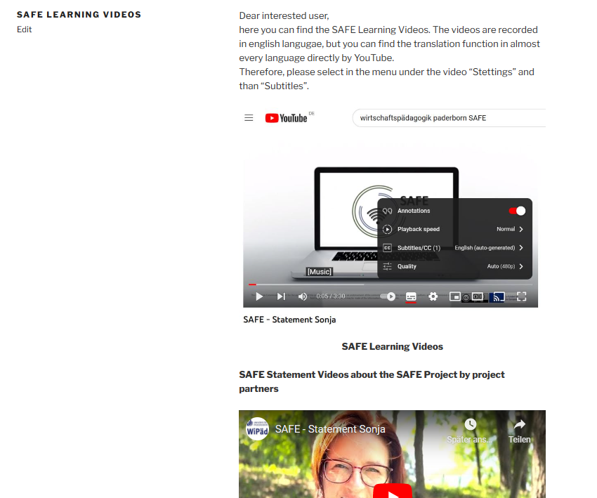
3 The SAFE Learning Videos
SAFE Learning Videos – SAFE – Streaming Approaches for Europe (eduproject.eu)
Link to the Platform: https://safe.eduproject.eu/index.php/safe-learning-videos/

Slide 4
SAFE Skript
SAFE Learning Videos – SAFE – Streaming Approaches for Europe (eduproject.eu)
Working in groups:
Creating individual skrips for the SAFE Learning Videos
What aspects, focal points and special features should be considered in the video?

Slide 5
Universität Paderborn
Department Wirtschaftspädagogik Lehrstuhl Wirtschaftspädagogik II Warburger Str. 100
33098 Paderborn
http://www.upb.de/wipaed
http://https://safe.eduproject.eu/
Prof. Dr. Marc Beutner
Tel: +49 (0) 52 51 / 60 - 23 67
Fax: +49 (0) 52 51 / 60 - 35 63
E-Mail: marc.beutner@uni-paderborn.de
Jennifer Schneider
Tel: +49 (0) 5251 / 60 – 27 98
Fax: +49 (0) 52 51 / 60 - 35 63

