Slide 1
SAFE
Streaming Approaches for Europe
Transnational Partner Meeting 1
Online Kick- Off Meeting
08th of July, 2021
The Erasmus+ project SAFE
Partner Presentation
University of Paderborn
Reference Number:
2020-1-DE03-KA226-SCH-093590
Aktenzeichen der NA:
VG-226-IN-NW-20-24-093590
Duration:
01.03.2021 to 28.02.2023 (24 month)
Chair of Business and Human Resource Education II
Prof. Dr. Marc Beutner

Slide 2

Table of Content
Transnational Project Meetings (TMP)
General Overview: Intellectual Outputs of SAFE
  Intellectual Outputs IO1 – IO7: Teachers/ Trainers/ Researchers/ Youth workers and Technicians
    In Detail: IO1 SAFE – Acceptance of eLearning and streaming #
    in school education in times of COVID-19
    In Detail: IO2 SAFE – The streaming concept for schools
The DISK – Online Approach
  The four DISK implemetation levels
  DISK streaming in class
  Disk streaming from home
  DISK with several schools
    In Detail: IO3 SAFE – Teacher training course on Streamlabs OBS and use of streaming platforms
    In Detail: IO4 SAFE – Implementation and evaluation at schools
    In Detail: IO5 SAFE – Creation of streaming videos, didactic materials
    In Detail: IO6 SAFE – The teacher handbook on the eLearning approach and the SAFE-Streaming-in-School-Education-book
    In Detail: IO7 SAFE – Policy Paper and Layman ́s report learning with streaming tools
Multiplier Events of SAFE
See SAFE Presentation:
SAFE DISK Online approach

Slide 3
Transnational Project Meetings (TMP)

Slide 4
Transnational Project Meetings (TPM)
TPM 1: SAFE – Kick Off Meeting (today)
TPM 2: SAFE – Streaming Concept Meeting
TPM 3: SAFE – Didactic Design and Implementation Meeting
TPM 4: SAFE – Final Meeting

Slide 5
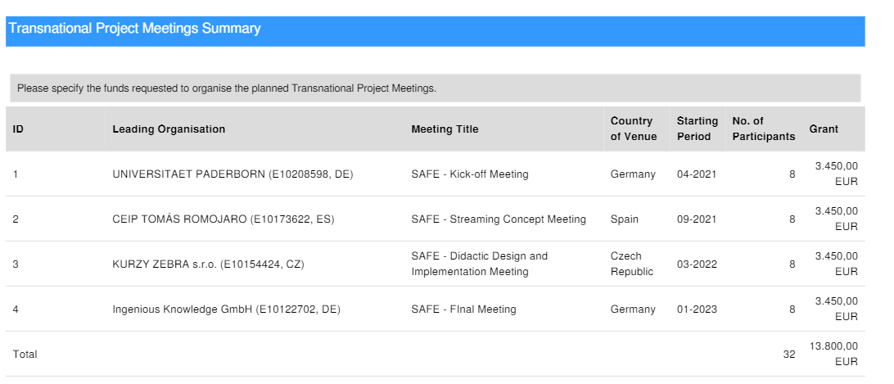
Transnational Project Meetings

Slide 6
Overview on the
Transnational Meetings of the SAFE project
Meetings
of the SAFE project
Start: 01-03- 2021
Duration: 24 months
Meeting 4
Final Meeting
Cologne, Gemany
Meeting 3
Didactic Design and Implementation Meeting
Czech Republic
Meeting 2
Streaming Concept Meeting
Spain
Meeting 1
KICK- OFF Meeting
Paderborn, Germany
Phase of
Constitution
Start of the
project
1st of March 2021
07-2021
10/11 -2021
03/04-2021
01-2023
- Finish -
of the project
March 2023

Slide 7
General Overview:
Intellectual Outputs of SAFE

Slide 8
The 7 Intellectual Outputs of SAFE:
Staff costs for Teachers/Trainers/Researchers/Youth workers/ Technicians
IO1 SAFE – Acceptance of eLearning and streaming in school education in times of COVID-19
IO2 SAFE – The streaming concept for schools
IO3 SAFE – Teacher training course on Streamlabs OBS and use of streaming platforms
IO4 SAFE – Implementation and evaluation at schools
IO5 SAFE – Creation of streaming videos, didactic materials
IO6 SAFE – The teacher handbook on the eLearning approach and the SAFE-Streaming-in-School-Education-book
IO7 - SAFE - Policy Paper and Layman´s report learning with streaming tools
Not financed by the NA/EU –
no staff budget
Not financed by the NA/EU –
no staff budget
Not financed by the NA/EU –
no staff budget

Slide 9
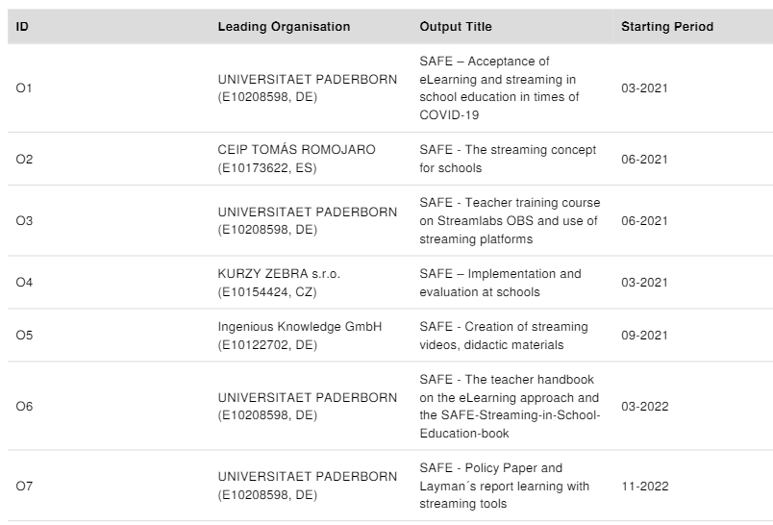
Intellectual Outputs of SAFE
Starting Period: important for the financial reporting
In Detail

Slide 10
General Overview:
Intellectual Outputs SAFE
In Detail: IO1 – IO4

Slide 11
Not financed by the NA/EU –
no staff budget
General Overview: Intellectual Outputs of SAFE
In Detail: IO1 SAFE – Acceptance of eLearning and streaming #
in school education in times of COVID-19

Slide 12
IO1 SAFE – Acceptance of eLearning and streaming # in school education in times of COVID-19
Start date: 01.03.2021
End date: 01.03.2022
Leading Organisation: University of Paderborn
Languages: DE, EN, CZ, ES
IO1-A1: SAFE Streaming approach based on the DISK-online model
IO1- A2: SAFE curriculum and corresponding eLearning course units for teacher education
IO1- A3 Desktop Research: Acceptance of Streaming
IO1- A4 Desktop Research: Streaming in school education in times of COVID- 19
Tasks to do – IO1

Slide 13
IO1 SAFE – Acceptance of eLearning and streaming # in school education in times of COVID-19
IO1-A1: SAFE Streaming approach based
on the DISK-online model
  Developing a learner and teacher orientated streaming approach which focus on (cross- cutting/ interdisciplinary) competencies and skills as well as learner/ teacher needs for successful embedding in a blended learning scenario

Slide 14
IO1 SAFE – Acceptance of eLearning and streaming # in school education in times of COVID-19
IO1- A2: SAFE curriculum and corresponding eLearning course
units for teacher education
IO1-A2 SAFE Curriculum: support effective and innovative learning
Tasks to do – IO1
IO1- A2 SAFE Learning Outcomes Approach (Learning Outcome Matrix)
IO1- A2 SAFE eLearning Course for teacher education
IO1- A2 SAFE Training Resources / Classroom materials
Additional training resource to facilitate the engagement teaching professionals with the new curriculum resources and streaming concept

Slide 15
IO1 SAFE – Acceptance of eLearning and streaming # in school education in times of COVID-19
IO1- A2 SAFE Curriculum
The curriculum framework will present content and learning outcome guidance notes on a module by module basis to support the development work of partners ensuring that all the areas of required learning identified are appropriately considered and addressed.
The curriculum will comprise approximately 80 hours of learning broken down into approximately 40 hours of face-to-face classroom or workshop instruction and 40 hours of self-directed learning.

Slide 16
IO1 SAFE – Acceptance of eLearning and streaming # in school education in times of COVID-19
IO1- A2 SAFE Learning Outcomes Approach
(Learning Outcome Matrix – LOM)
  First draft of the SAFE LOM available at the SAFE Website under downloads.

Slide 17
IO1 SAFE – Acceptance of eLearning and streaming # in school education in times of COVID-19
IO1- A2 SAFE Learning Outcomes Approach
(Learning Outcome Matrix)
  key element of the pedagogic strategy
  allows individual learning content to be localised to take account of the different cultural patterns in partner countries without compromising the value of the learning resource

Slide 18
IO1 SAFE – Acceptance of eLearning and streaming # in school education in times of COVID-19
IO1- A2 SAFE eLearning Course for teacher education
SAFE eLearning Course for teacher education
1. Course: General Information about the Erasmus+ Project SAFE
2. Course: SAFE Streaming in school education – blended learning approach
3. Course: SAFE Curriculum, competences and didactical materials (Classroom Materials)

Slide 19
IO1 SAFE – Acceptance of eLearning and streaming # in school education in times of COVID-19
IO1- A2 SAFE Training Resources/ Classroom Materials:
Additional training resource to facilitate the engagement teaching professionals with the new curriculum resources and streaming concept
SAFE Classroom materials for the teacher training
Classroom Material: General Information about the Erasmus+ Project SAFE
Classroom Material: SAFE Curriculum, competences and didactical materials
Classroom Material: SAFE Streaming in school education – blended learning approach

Slide 20
IO1 SAFE – Acceptance of eLearning and streaming # in school education in times of COVID-19
IO1- A3 Desktop Research: Acceptance of Streaming (all partners)
Research in each partner country will have a very close look at the acceptance of streaming under the specific national and regional requirements:
(1) identify teacher training modules to be developed in the SAFE curriculum;
(2) highlight topics to be addressed in the in the teacher training courses by the teaching professionals;
(3) focus on the design of the course modules to ensure that high-quality standards are achieved in content production as well as
(4) get a common feedback on the use of streaming and prior knowledge of the teachers.

Slide 21
IO1 SAFE – Acceptance of eLearning and streaming # in school education in times of COVID-19
IO1- A3 Desktop Research: Acceptance of Streaming (all partners)
Research framework available on the SAFE website.

Slide 22
IO1 SAFE – Acceptance of eLearning and streaming # in school education in times of COVID-19
IO1- A4 Desktop Research: Streaming in school education in times of COVID- 19
Research framework and oversee the management of required research.
(1) what are the key skill areas that need to be addressed in the teacher training curriculum with regard to hybrid streaming approaches based on the DISK-model;
(2) what are the key skill levels that are appropriate for local teachers and local learners;
(3) what existing resources could be used or re-designed for use in the courses and the curriculum to avoid duplication;
(4) what are the most appropriate media formats for learning content within the teacher training in each partner country;
(5) what type of assessment framework would be most appropriate to facilitate the measurement of attainment;
(6) what types of pedagogic supports are needed to facilitate the schools, teachers and tutors. This list of topics is only indicative of the type of questions that the research will address

Slide 23
IO1 SAFE – Acceptance of eLearning and streaming # in school education in times of COVID-19
IO1- A4 Desktop Research: Streaming in school education
in times of COVID- 19 (all partners)
Research framework available on the SAFE website

Slide 24
General Overview: Intellectual Outputs of SAFE
In Detail: IO2 SAFE – The streaming concept for schools

Slide 25
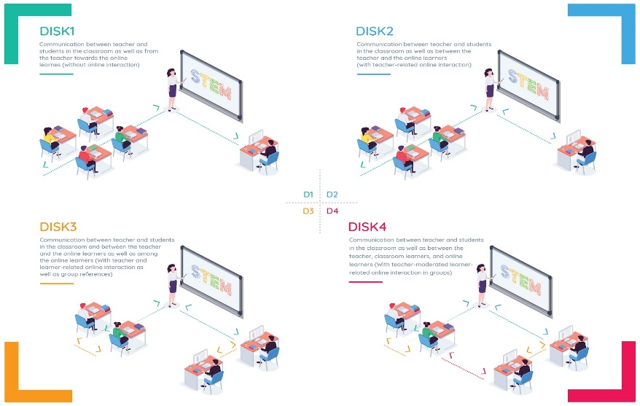
O2 SAFE – The streaming concept for schools
Start date: 01.06.2021
End date: 01.10.2021
Leading Organisation: CEIP TOMÁS ROMOJARO
Languages: DE, EN, CZ, ES
The DISK-Online Approach was developed and tested in 2020 under the restrictions of COVID-19
Basis for the streaming Concept for schools is the DISK-Online model of Beutner/Pechuel 2020

Slide 26
IO2 SAFE – The streaming concept for schools
IO2- A1 The SAFE- streaming concept
based on the DISK-Online approach
The concept design bases on the results of the IO research and take also the local school situations into account. The concept design will be the basis for the streaming evaluation in the following IOs (IO3, IO4and IO5) and the heart of the the topics which will be addressed in the following teacher training course in IO3.
The consortium will adapt this approach to a common European one which focusses also on the different educational environments and cultures in Europe and especially in the SAFE partner countries.
Each school has to adjust the concept to the local and regional requirements and the technical equipment. Therefore, the different step-by-step solutions within the DISK-Online approach (DISK1, DISK2, DISK3 and DISK4) can be the basis for the national approaches and in combination of the SAFE results a common European approach can be created.
'ab initio' approach

Slide 27
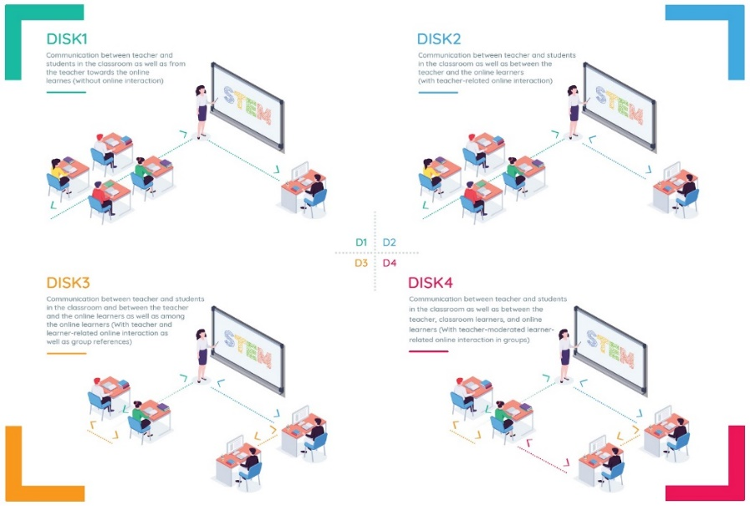
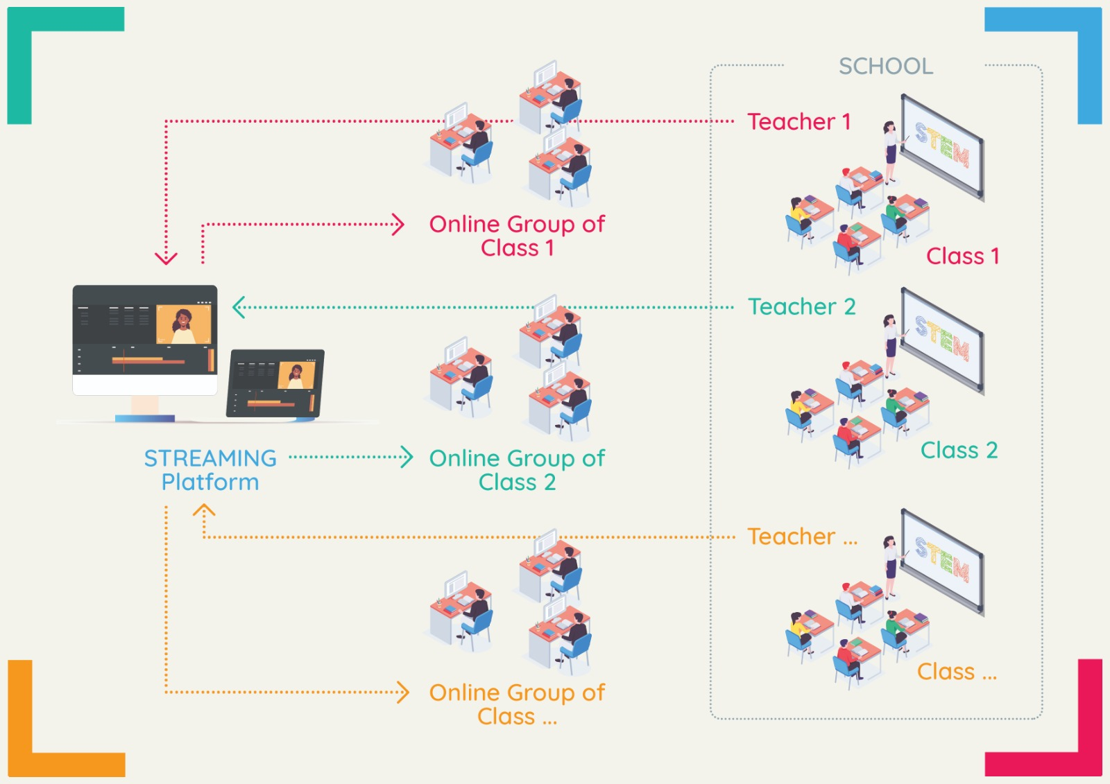
THE DISK – Online Approach
(Beutner/ Pechuel 2020)
More information on the
SAFE project website
Presentation:
THE DISK – Online Approach

Slide 28
IO2 SAFE – The streaming concept for schools
To sum up:
I. IK and UPB: Deliver a first (IO1-A2) SAFE streaming concept
II. School partners CEIP and ZEBRA: will revise the streaming concept for schools according to their national and regional needs and provide national versions

Slide 29
General Overview: Intellectual Outputs of SAFE
In Detail: IO3 SAFE – Teacher training course on Streamlabs OBS and use of streaming platforms

Slide 30
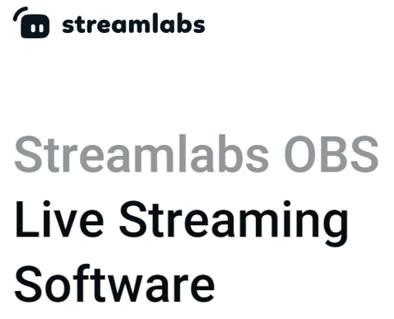
IO3 SAFE – Teacher training course on
Streamlabs OBS and use of streaming platforms
Start date: 01.06.2021
End date: 01.06.2022
Leading Organisation: University Paderborn
Languages: DE, EN, CZ, ES
IO3 SAFE – Teacher training course on Streamlabs OBS and use of streaming platforms
Modular teacher training curriculum for streaming at schools will be developed as a basis for the online courses and learning modules on the learning platform to be developed.
The idea: to support the acquisition of key high-value competences necessary for the establishing modern and innovative learning with as comparable European focus which works under COVID-19.
Streamlabs OBS is a registered trade mark

Slide 31
IO3 SAFE – Teacher training course on
Streamlabs OBS and use of streaming platforms
IO3 SAFE Teacher training course on Streamlabs OBS and use of streaming platforms
Aspect (1): Streaming platform
Module 1: Streaming is easy: Streaming platforms and their use for school education
Module 2: How to stream: Introduction to Twitch as and example of a running streaming platform
Module 3: Get connected: Connecting streaming platforms by teachers
Aspect (2): Streaming software
Module 4: Stream yourself: Introduction to the use of the streaming software Streamlabs OBS
Module 5: Overview: Alternatives to the streaming software Streamlabs OBS
Module 6: My first stream: Going online - First streaming
Aspect (3): Streaming Environment
Module 7: Easy school requirements: Technical and organisational requirements at school and for teachers
Module 8: Easy learner requirements: Technical and organisational requirements for learners

Slide 32
IO3 SAFE – Teacher training course on
Streamlabs OBS and use of streaming platforms
IO3 SAFE Teacher training course on Streamlabs OBS and use of streaming platforms
Classroom Materials (1): Streaming platform
Classroom Materials for Module 1: Streaming is easy: Streaming platforms and their use for school education
Classroom Materials for Module 2: How to stream: Introduction to Twitch as and example of a running streaming platform
Classroom Materials for Module 3: Get connected: Conecting streaming platforms by teachers
Classroom Material (2): Streaming software
Classroom Materials for Module 4: Stream yourself: Introduction to the use of the streaming software Streamlabs OBS
Classroom Materials for Module 5: Overview: Alternatives to the streaming software Streamlabs OBS
Classroom Materials for Module 6: My first stream: Going online - First streaming
Classroom Material (3): Streaming Environment
Classroom Materials for Module 7: Easy school requirements: Technical and organisational requirements at school and for teachers
Classroom Materials for Module 8: Easy learner requirements: Technical and organisational requirements for learners

Slide 33
IO3 SAFE – Teacher training course on
Streamlabs OBS and use of streaming platforms
To sum up – IO3 includes:
IO3- A1: 8 Teacher training courses about streaming
IO3- A2: 8 Classroom materials which fit to the teacher training courses
IO3- A3: SAFE Teacher training curriculum
IO3- A4: SAFE Learning Outcomes Matrix for Teacher training courses
IO3 SAFE – Teacher training course on Streamlabs OBS and use of streaming platforms

Slide 34
Not financed by the NA/EU –
no staff budget
General Overview: Intellectual Outputs of SAFE
In Detail: IO4 SAFE – Implementation and evaluation at schools

Slide 35
IO4 SAFE – Implementation and evaluation at schools
Start date: 01.06.2021
End date: 01.12.2022
Leading Organisation: Kurzy ZEBRA s.r.o.
Languages: DE, EN, CZ, ES
There are two implementations in SAFE:
(a) The implementation of the teacher training course (here are teacher learning how to handle streaming) and
(b) The implementation of streaming in lessons with learners (here teachers implement the Streaming approach for schools in their lessons)

Slide 36
IO4 SAFE – Implementation and evaluation at schools
(a) The implementation of the teacher training course
Idea: teacher should learn how to handle streaming
Web- based online course: will be provided via a learning platform created in the project.
Opportunities & Benefits:
SAFE teacher training courses can be accessed from anywhere in the world
offers the possibility to create the courses in multiple languages and tests and tasks can be integrated easily
SAFE teacher training courses come with introductions, address concrete objectives, offer descriptions and explanations as well as rationales
include interactive tasks and can include videos as well as audios, photos, images and illustrations

Slide 37
IO4 SAFE – Implementation and evaluation at schools
(a) The implementation of the teacher training course
Idea: teacher should learn how to handle streaming
Web- based online course: will be provided via a learning platform created in the project.
Learning platform: designed to provide teachers, educators, administrators and learners with a single robust, secure and integrated system to create personalised learning environments.
Opportunities & Benefits:
The use of the survey elements provides a variety of proven questionnaire instruments for discovering interesting information about the state of mind of the SAFE teacher training target group.

Slide 38
IO4 SAFE – Implementation and evaluation at schools
(b) The implementation of streaming in lessons with learners
Idea: teachers implement the Streaming approach for schools in their lessons
After teachers actively participated in the streaming course they will be able to do streaming on their own in their classes. The teachers will implement DISK1, DISK2, DISK3 or DISK4 or a specific adjustment of the DISK-online approach within their teaching.

Slide 39
IO4 SAFE – Implementation and evaluation at schools
CEIP and ZEBRA:
implementation of the teacher training course.
implementation of the streaming in lessons with learners
the translation of the implementation evalauation report.
ZEBRA:
steer the work in this IO.
UPB and IK:
to get online support
design of the evaluation tools
data handling and analysis of the results of the implementation of the teacher training course.
data handling and analysis of the results of the implementation of the streaming in lessons with learners.
Tasks to do:

Slide 40
IO4 SAFE – Implementation and evaluation at schools
Tasks to do:
UPB:
  write and compile an evaluation report on the implementations.
IK:
  technical support and creating online survey tools and support the data collection online.

Slide 41
General Overview: Intellectual Outputs of SAFE
In Detail: IO5 SAFE – Creation of streaming videos, didactic materials

Slide 42
IO5 SAFE – Creation of streaming videos, didactic materials
Start date: 01.09.2021
End date: 01.12.2022
Leading Organisation: Ingenious Knowledge
Languages: DE, EN, CZ, ES
IO5 SAFE – Creation of streaming videos, didactic materials
streaming videos will be recorded, and provided
To support blended learning and also the transfer of the project results it is important to provide pedagogical resources, didactic materials and additional learning materials.
information on the streaming activities are important.
The curriculum goes hand in hand with such videos and didactical materials and resources for teachers who want to integrate it in their lessons. The additional didactic materials, the learning and teaching and the streaming videos will be OER.

Slide 43
IO5 SAFE – Creation of streaming videos, didactic materials
To sum up:
All partners:
CEIP, ZEBRA and UPB:
Translation
IK:
Layouting and technical support
work on the didactic materials. writing and recording, creating graphics, creating layout, proof reading and redesign.
will all be active in the creation and development processes
video creation, cut and rendering.

Slide 44
General Overview: Intellectual Outputs of SAFE
In Detail: IO6 SAFE – The teacher handbook on the eLearning approach and the SAFE-Streaming-in-School-Education-book

Slide 45
IO6 SAFE – The teacher handbook on the eLearning approach and the
SAFE-Streaming-in-School-Education-book
Start date: 01.03.2022
End date: 28.02.2023
Leading Organisation: University of Paderborn
Languages: EN
IO6 – SAFE teacher handbook on eLearning approach and the SAFE- Streaming in School Education book
A real published book with for eLearning approach and the SAFE Streaming approach, with
  hints, help and guidelines which will be available on the book market.
provides information about innovative learning processes using streaming at school.
Target group:
teachers, trainers and schools as well as all interested readers about streaming approaches in school

Slide 46
IO6 SAFE – The teacher handbook on the eLearning approach and the
SAFE-Streaming-in-School-Education-book
IO6 – SAFE teacher handbook on eLearning approach and the SAFE- Streaming in School Education book
First draft – SAFE book
Table of content
Overview on the current situation under COVID-19
Overview on the DISK-Online approach
Overview on the streaming for Schools European Concept
  Insights in the acceptance research
  the chances and challenges of the teacher training SAFE course
  the SAFE teacher training curriculum
Evaluation results of the SAFE Implementation
A Step-by-Step guide to enter Streamlabs OBS and the streaming platform
  Challenges and Chances
  Future developments
Etc.

Slide 47
IO6 SAFE – The teacher handbook on the eLearning approach and the
SAFE-Streaming-in-School-Education-book
To sum up:
UPB:
IK:
moderating the process
work on technical issues, proof reading and redesign, general book layout
UPB, IK, CEIP and ZEBRA:
will all be active in the creation, development and writing processes.
book guideline concept, structuring process for writing,
creating graphics, layout, proof reading and redesign
summaries feedback
setting of the book,
organizing the print
UPB and IK:
will create a first draft of the SAFE book, which will be the starting point for discussion for the next meeting

Slide 48
Not financed by the NA/EU –
no staff budget
General Overview: Intellectual Outputs of SAFE
In Detail: IO7 SAFE – Policy Paper and Layman ́s report learning
with streaming tools

Slide 49
IO7 SAFE – Policy Paper and Layman ́s report learning with streaming tools
Start date: 01.11.2022
End date: 28.02.2023
Leading Organisation: University of Paderborn
Languages: EN, DE, CZ, ES
IO7 SAFE – Policy Paper and Layman´s report
IO7 – A1 SAFE Policy Paper
IO7 – A2 SAFE Layman´s report

Slide 50
IO7 SAFE – Policy Paper and Layman ́s report learning with streaming tools
IO7- A1 SAFE Policy Paper
Consider the following key issues:
the importance of the use of new media approaches, eLearning activities and streaming in school education in times of COVID 19 and in the future
the need to focus on new emerging opportunities of learning with innovative approaches
the need of a solid and attuned common curricular approach
the importance streaming in school education in the future
the structure of the online teacher training and its results
the results of the experiences with the streaming approach
Insights in evaluation results and recommendations
The policy paper: will consider a change of policy (insights in: pros and cons of each option)

Slide 51
IO7 SAFE – Policy Paper and Layman ́s report learning with streaming tools
IO7- A2 SAFE Layman´s report
IO7 – A2 SAFE Layman ́s report
summarises the work of the project for a general audience
it will provide a general and brief overview
in easy and understandable words.
provide the core information in short

Slide 52
IO7 SAFE – Policy Paper and Layman ́s report learning with streaming tools
Tasks to do
UPB:
SAFE Policy Paper and Layman´s report:
All partners:
lead this action
draft the policy paper
the layman ́s report
based on the work of the Outcomes
based on the responses to a policy questionnaire which UPB will develop
translation of the reports by all partners
printed in all partner languages
available for download from the project website
available on the project’s social media accounts
design and layout the documents
creation the questionnaire, researching and drafting the policy paper.

Slide 53
Multiplier Events of SAFE

Slide 54
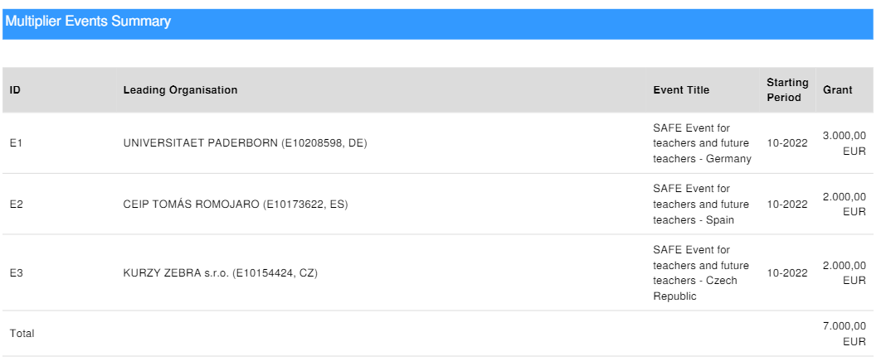
Multiplier Events
Start date: 01.10.2022
End date: 01.12.2022
Duration: One- day workshop

Slide 55
Multiplier Events
Start date: 01.10.2022
End date: 01.12.2022
Duration: One- day workshop

Slide 56
Multiplier Events
E1 SAFE – Event for teachers and future teachers – Germany
E1 SAFE – Event for teachers and future teachers – Spain
E1 SAFE – Event for teachers and future teachers – Czech Republic
A minimum of 30 VET teachers or future VET teacher as well as stakeholders will attend this event.
A minimum of 20 VET teachers or future VET teacher as well as stakeholders will attend this event.
A minimum of 20 VET teachers or future VET teacher as well as stakeholders will attend this event.
The participants in multiplier Events are from other organisations!
They don´t belong to the partner organisation!

Slide 57
Multiplier Events
Workshop Content:
In the workshop the results of the research and ideas about how to address eLearning with streaming approaches and the teach handbook are well as the didactic material are in focus. The event consists of six parts:
Part A: Insight into streaming and the acceptance of streaming in education
Part B: Presentation of a life stream with involvement of the target group
Part C: Insights into the teacher training course with its modules and materials
Part D: Discussions on the teacher handbook
Part E: Video presentations
Part F: Future perspectives and policy recommendations

Slide 58
Thank you for your attention!

Slide 59
Universität Paderborn
Department Wirtschaftspädagogik Lehrstuhl Wirtschaftspädagogik II Warburger Str. 100
33098 Paderborn
http://www.upb.de/wipaed
http://https://safe.eduproject.eu/
Prof. Dr. Marc Beutner
Tel: +49 (0) 52 51 / 60 - 23 67
Fax: +49 (0) 52 51 / 60 - 35 63
E-Mail: marc.beutner@uni-paderborn.de

