Slide 1
SAFE Streaming Approaches for Europe
Aspect (1): Streaming platform
Module 1: Streaming is easy: Streaming platforms and their use for school education
Module 2: How to stream: Introduction to Twitch as and example of a running streaming platform
Module 3: Get connected: Connecting streaming platforms by teachers
Reference Number: 2020-1-DE03-KA226-SCH-093590
Aktenzeichen der NA: VG-226-IN-NW-20-24-093590
Duration:
01.03.2021 to 28.02.2023 (24 month)
University of Paderborn Department of Business and Human Resource Education Chair of Business and Human Resource Education and Evaluation Research - Prof. Dr. Marc Beutner Jennifer Schneider

Slide 2
Aspect (1): Streaming platform
Module 2: How to stream: Introduction to Twitch as and example of a running streaming platform

Slide 3
Aspect (1): Streaming platform
Module 1: Streaming is easy: Streaming platforms and their use for school education
Focus on Module 2:
Module 2: How to stream: Introduction to Twitch as and example of a running streaming platform
Module 3: Get connected: Connecting streaming platforms by teachers

Slide 4
Content
General information about Streaming Platforms
How to stream? Introduction to the Streaming Platform Twitch
Introduction to Twitch
Twitch – A success story
Start Guide to Streaming on Twitch
Start Guide to Streaming on Twitch – selection of Streaming Software

Slide 5
General information about Streaming Platforms
What does streaming mean?
Generally speaking: Streaming means "playing content on your computer over the Internet or over a network."
In principle, the stream can be broadcast in parallel with a radio and television broadcast, as it is not stored on the receiving device - radio or television.
Technically:
During streaming, data packets are continuously transmitted and processed directly
CHIP (2021) Recieved form the Internet: https://praxistipps.chip.de/was-ist-streaming-einfach-erklaert_41250, access date: 04.11.2021.

Slide 6
General information about Streaming Platforms
Example:
When watching a YouTube video, the video file is actually downloaded in small parts to the end device (e.g. TV, computer, laptop or smartphone) and played directly without saving it permanently on your end device.
Attention:
However, this is NOT a conventional download of the data, as the data is not permanently stored locally, but is discarded immediately after playback.
CHIP (2021) Recieved form the Internet: https://praxistipps.chip.de/was-ist-streaming-einfach-erklaert_41250, access date: 04.11.2021.

Slide 7
How to stream
Introduction to the Streaming Platform Twitch

Slide 8
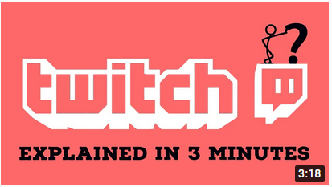
Introduction to Twitch
Visit the link and see the YouTube Video: https://www.youtube.com/watch?v=OWFaV8Nymzs

Slide 9
Introduction to Twitch
Twitch or Twitch.tv is a live streaming platform as well as SVoD that is primarily known for the transmission and distribution of video games and video game effects
In 2007, Justin Kan founded the streaming platform Justin.TV, on which everything could be streamed that the community was interested in
It quickly became apparent that gaming was the largest and most popular area, so Twitch was founded in 2011
Source: https://www.affde.com/de/twitch-stats.html
BusinessWire (2011): Retrieved from the Internet: https://www.businesswire.com/news/home/20120501006328/en#.UswTBtLuJ8F; access date: 14.10.2021.
(FAZ (2014): Retrieved from the Internet: https://www.faz.net/aktuell/wirtschaft/netzwirtschaft/konkurrenz-zu-google-amazon-kauft-video-webseite-twitch-fuer-eine-milliarde-dollar-13117112.html; access date: 14.10.2021).

Slide 10
Introduction to Twitch
What is possible on Twitch?
Primarily for the transmission and exchange of gaming
But the "Just Chatting" function is also very popular
Streamers simply chat with viewers in front of the camera
Series and films can be viewed and commented on together
Creates a sense of belonging
Source: https://www.affde.com/de/twitch-stats.html
(BusinessWire (2011): Retrieved from the Internet: https://www.businesswire.com/news/home/20120501006328/en#.UswTBtLuJ8F; access date: 14.10.2021.
(FAZ (2014): Retrieved from the Internet: https://www.faz.net/aktuell/wirtschaft/netzwirtschaft/konkurrenz-zu-google-amazon-kauft-video-webseite-twitch-fuer-eine-milliarde-dollar-13117112.html; access date: 14.10.2021).

Slide 11
Twitch – A success story
The Twitch success story
Spin-off from Justin.tv: Twitch founded in 2011
May 2012 Twitch won a Webby Award:
Title Webby People’s Voice Award in the Video Games category (BusinessWire, 2011)
In 2014, Amazon took over the company for 970 million US dollars (FAZ, 2014)
More than 185 million unique streams were broadcast in 2019
Of those 185 million streams, approximately 404 million hours of content were created
Approximately 54,500 channels are live at any one time
Approximately 44 billion minutes are streamed per month
Almost a million people are watching streams at any one time
Twitch has an average of just over 997,000 active users at any given point in time
15 million people use Twitch every day
Source: https://www.affde.com/de/twitch-stats.html
(BusinessWire (2011): Retrieved from the Internet: https://www.businesswire.com/news/home/20120501006328/en#.UswTBtLuJ8F; access date: 14.10.2021.
(FAZ (2014): Retrieved from the Internet: https://www.faz.net/aktuell/wirtschaft/netzwirtschaft/konkurrenz-zu-google-amazon-kauft-video-webseite-twitch-fuer-eine-milliarde-dollar-13117112.html; access date: 14.10.2021).

Slide 12
Twitch – A success story
Twitch Sings: November 2019 to January 1, 2021
Selection of various karaoke styles and selection of different songs that will be performed in the stream
Fan reactions and challenges could be noticed directly
The success story goes on and on:
In 2021 the interest and the community of Twitch grew again and a stagnation is not in sight!
This is not at least one reason of the corona pandemic and the associated contact restrictions, but at the same time also the constantly growing social media community and perception of the social media stars, who, in addition to Instagram and YouTube as well Twitch, is increasingly promoting and actively using it and exhausting it as a marketing tool and business model.
Source: https://www.affde.com/de/twitch-stats.html
(BusinessWire (2011): Retrieved from the Internet: https://www.businesswire.com/news/home/20120501006328/en#.UswTBtLuJ8F; access date: 14.10.2021.
(FAZ (2014): Retrieved from the Internet: https://www.faz.net/aktuell/wirtschaft/netzwirtschaft/konkurrenz-zu-google-amazon-kauft-video-webseite-twitch-fuer-eine-milliarde-dollar-13117112.html; access date: 14.10.2021).

Slide 13
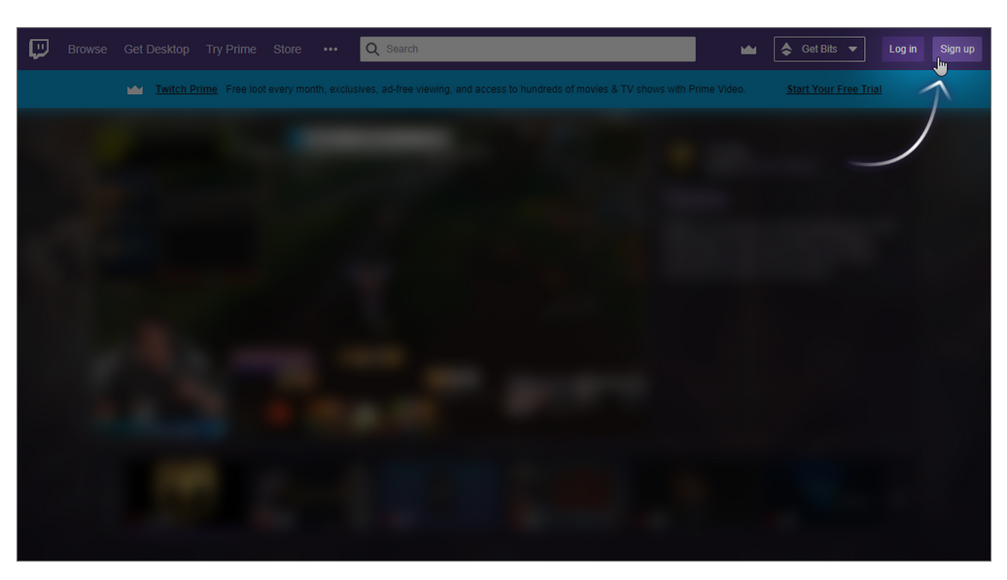
Start Guide to Streaming on Twitch
Start Guide to Streaming on Twitch
Few simple steps to stream art, music or gameplay!
1. First, create a Twitch account.
It is recommended to download the Twitch App on iOS or Androide mobile devices, this allows flexibility in using the streams and go live wherever the user is and goes.
Twitch (2021): Retrieved from the Internethttps://www.twitch.tv/creatorcamp/en/setting-up-your-stream/quick-start-guide-to-streaming-on-twitch/; access date:14.10.2021.

Slide 14
Start Guide to Streaming on Twitch
1. Create an Account with Twitch
Here the link to „Create an Account with Twitch“:
https://help.twitch.tv/s/article/creating-an-account-with-twitch?language=en_US
Get a guidiance throw the single steps to create your account!
Twitch (2021): Retrieved from the Internethttps://www.twitch.tv/creatorcamp/en/setting-up-your-stream/quick-start-guide-to-streaming-on-twitch/; access date:14.10.2021.

Slide 15
Start Guide to Streaming on Twitch
2. Review the Community Guidelines and Terms of Service fully.
It’s also recommended to establish Moderation and Safety settings before first stream to ensure the best experience for you and your growing community.
AutoMod is a tool to serve as first line of defense for moderation, with settings to adjust your preferences.
Twitch (2021): Retrieved from the Internethttps://www.twitch.tv/creatorcamp/en/setting-up-your-stream/quick-start-guide-to-streaming-on-twitch/; access date:14.10.2021.

Slide 16
Start Guide to Streaming on Twitch
3. Customize your channel
New viewers get to know who you are and where to find you! What are your unique selling proposition (USP): modify your profile photo and bio via your mobile device, or customize a number of additional settings via a web browser.
Twitch set up a Creator Camp page on Personal Branding to inform user to customize their channel page, to reflect themselves and their brand.
Twitch (2021): Retrieved from the Internethttps://www.twitch.tv/creatorcamp/en/setting-up-your-stream/quick-start-guide-to-streaming-on-twitch/; access date:14.10.2021.

Slide 17
Start Guide to Streaming on Twitch
4. Optimize your set up!
Information about necessary hardware needed to stream and optimize the audio and visuals.
Helpful guides: Setting Up Your Stream.
It doesn’t have to be complicated! With a Playstation or Xbox, it’s likely to go live in just a matter of minutes.
Twitch (2021): Retrieved from the Internethttps://www.twitch.tv/creatorcamp/en/setting-up-your-stream/quick-start-guide-to-streaming-on-twitch/; access date:14.10.2021.

Slide 18
Start Guide to Streaming on Twitch
5. Select and set up your broadcasting software.
Twitch Studio is available for Windows and Mac and Twitch’s first-party streaming software that makes it easy to set up a stream and go live in minutes!
Guided onboarding: helps automatically to detect microphone, webcam, and other technical aspects of a stream
pre-loaded starter layouts help creators effortlessly personalize the look of their stream
Alerts and Chat are built-in, helping you easily monitor channel activity and interact with users of the community
Twitch (2021): Retrieved from the Internethttps://www.twitch.tv/creatorcamp/en/setting-up-your-stream/quick-start-guide-to-streaming-on-twitch/; access date:14.10.2021.

Slide 19
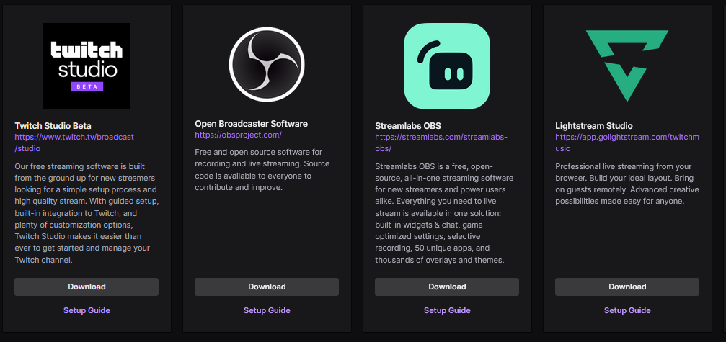
Start Guide to Streaming on Twitch – selection of Streaming Software
Twitch.tv (2021): Retrieved from the internet: https://dashboard.twitch.tv/u/jenniferupb/broadcast Zugriff: 04.11.2021
Streamlabs OBS (2021): Im Internet: https://streamlabs.com/downloads
Access date: 14.10.2021.

Slide 20
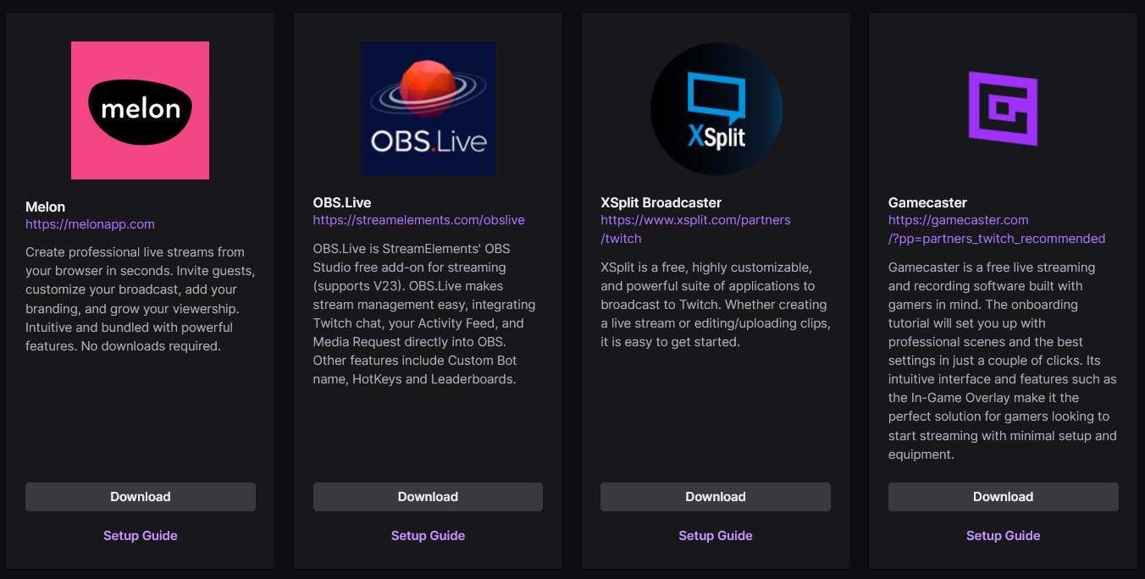
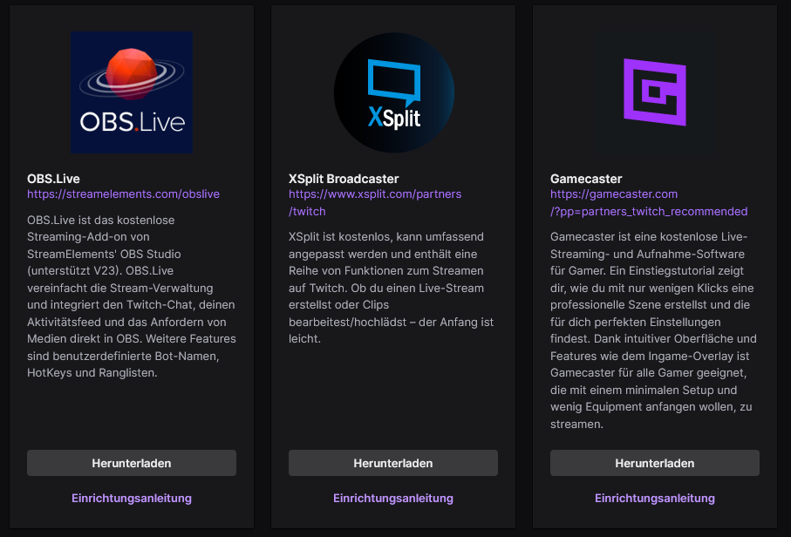
Start Guide to Streaming on Twitch – selection of Streaming Software
Twitch.tv (2021): Retrieved from the internet: https://dashboard.twitch.tv/u/jenniferupb/broadcast Zugriff: 04.11.2021
Streamlabs OBS (2021): Im Internet: https://streamlabs.com/downloads
Access date: 14.10.2021.

Slide 21
Start Guide to Streaming on Twitch – selection of Streaming Software
5. Select and set up your broadcasting software!
The consortium of the Erasmus + project SAFE recommends the use of Streamlabs OBS
Here is the link to download the streaming software Streamlabs OBS:
https://streamlabs.com/downloads
Twitch.tv (2021): Retrieved from the internet: https://dashboard.twitch.tv/u/jenniferupb/broadcast Zugriff: 04.11.2021
Streamlabs OBS (2021): Im Internet: https://streamlabs.com/downloads
Access date: 14.10.2021.

Slide 22
Start Guide to Streaming on Twitch
6. Add a few extensions to your channel
Creator Dashboard: navigate to the Extensions tab right above the Creator Camp link
try out the CTRL+ and Sound Alerts extensions to enhance the community viewing experience and drive viewer participation.
Twitch (2021): Retrieved from the Internethttps://www.twitch.tv/creatorcamp/en/setting-up-your-stream/quick-start-guide-to-streaming-on-twitch/; access date:14.10.2021.

Slide 23
Start Guide to Streaming on Twitch
Congratulation!
Now, you’re ready to go live!
Don’t forget to title, categorize and tag the stream! That’s the way potential viewers and community can find the channel!
Here some impressions and further information about helpful tutorials
Twitch (2021): Retrieved from the Internethttps://www.twitch.tv/creatorcamp/en/setting-up-your-stream/quick-start-guide-to-streaming-on-twitch/; access date:14.10.2021.

Slide 24
References
Online Ressources:
Affde (2021): Rerieved from the Internet: https://www.affde.com/de/twitch-stats.html, access date: 04.10.2021.
BusinessWire (2011): Retrieved from the Internet: https://www.businesswire.com/news/home/20120501006328/en#.UswTBtLuJ8F; access date: 14.10.2021.
CHIP (2021) Rerieved form the Internet: https://praxistipps.chip.de/was-ist-streaming-einfach-erklaert_41250, access date: 04.11.2021.
FAZ (2014): Retrieved from the Internet: https://www.faz.net/aktuell/wirtschaft/netzwirtschaft/konkurrenz-zu-google-amazon-kauft-video-webseite-twitch-fuer-eine-milliarde-dollar-13117112.html; access date: 14.10.2021.
Streamlabs OBS (2021): Im Internet: https://streamlabs.com/downloads, access date: 14.10.2021.
Twitch (2021): Retrieved from the Internet: https://www.twitch.tv/creatorcamp/en/setting-up-your-stream/quick-start-guide-to-streaming-on-twitch/, access date:14.10.2021.
Twitch Explained in 3 Minutes (2021): Recieved from the Internet: https://www.youtube.com/watch?v=OWFaV8Nymzs, access date: 04.11.2021.
Twitch.tv (2021a): Retrieved from the internet: https://dashboard.twitch.tv/u/jenniferupb/broadcast Zugriff: 04.11.2021

Slide 25
References
Fotos:
Unsplash:
“Unsplash photos are made to be used freely. Our license reflects that. All photos can be downloaded and used for free Commercial and non-commercial purposes No permission needed (though attribution is appreciated!) What is not permitted 👎 Photos cannot be sold without significant modification. Compiling photos from Unsplash to replicate a similar or competing service” (https://unsplash.com/license)
Pixabay
“Was ist erlaubt? ✓ Du darfst alle Pixabay Inhalte kostenlos nutzen, für kommerzielle und nicht-kommerzielle Anwendungen, gedruckt und digital. Beachte dabei die Einschränkungen unter "Was ist nicht erlaubt". ✓ Du musst weder vom Bildautor noch von Pixabay eine Genehmigung einholen und auch eine Quellenangabe ist nicht erforderlich, wobei wir uns über eine freiwillige Nennung freuen. ✓ Du darfst Pixabay Inhalte verändern“ (https://pixabay.com/de/service/license/).

Slide 26
Universität Paderborn
Department Wirtschaftspädagogik Lehrstuhl Wirtschaftspädagogik II Warburger Str. 100
33098 Paderborn
http://www.upb.de/wipaed
http://https://safe.eduproject.eu/
Prof. Dr. Marc Beutner
Tel: +49 (0) 52 51 / 60 - 23 67
Fax: +49 (0) 52 51 / 60 - 35 63
E-Mail: marc.beutner@uni-paderborn.de
Jennifer Schneider, M. Sc.
Tel: +49 (0) 52 51 / 60 - 5010
Fax: +49 (0) 52 51 / 60 - 35 63
E-Mail: Jennifer.Schneider@uni-paderborn.de

